Slide 1
Guatemala Caves
An NSS Audio-Visual
Library Presentation
Steve Knutson, 1992
S627 135 Slides 1/28/2021
Notes:
During the 1980’s cavers made several trips to explore the caves of Guatemala as part of the NSS “Lost World Explorations”.

Slide 2
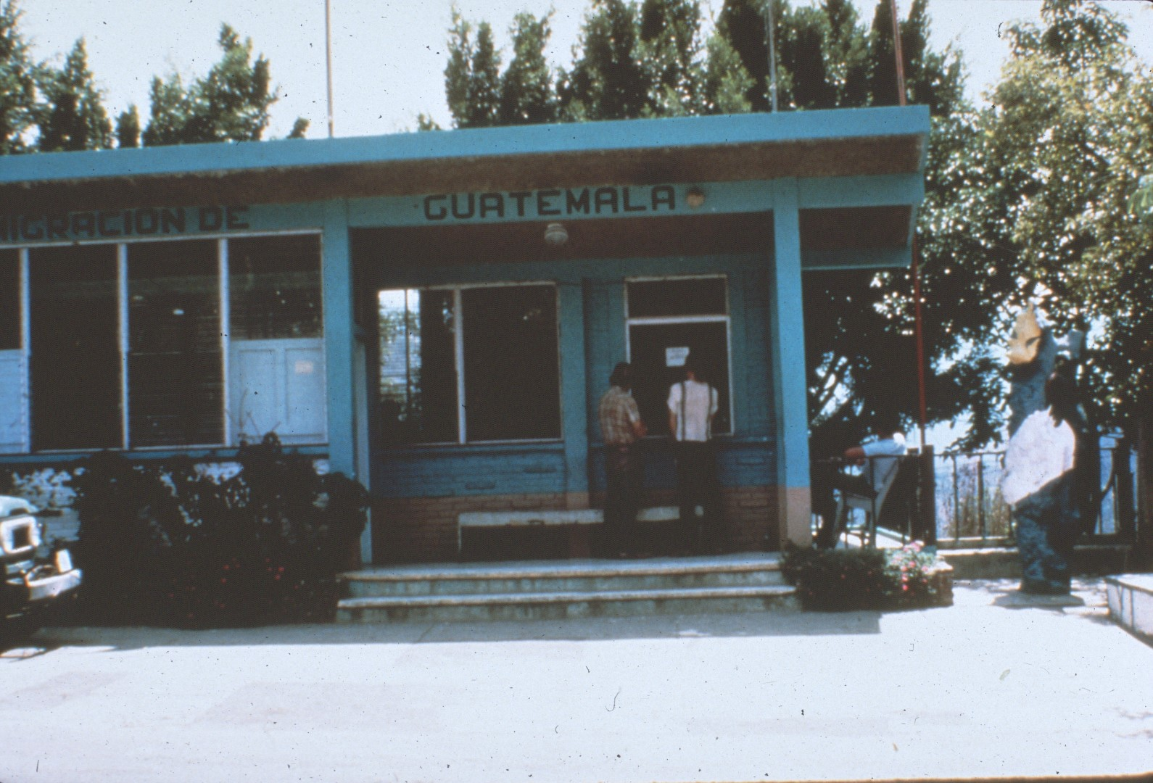
Notes:
Guatemala is located in Central America bordered by Mexico on the north, Belize on the east, Honduras and El Salvador on the south, and the Pacific Ocean on the west. The country is about the size of Ohio.

Slide 3
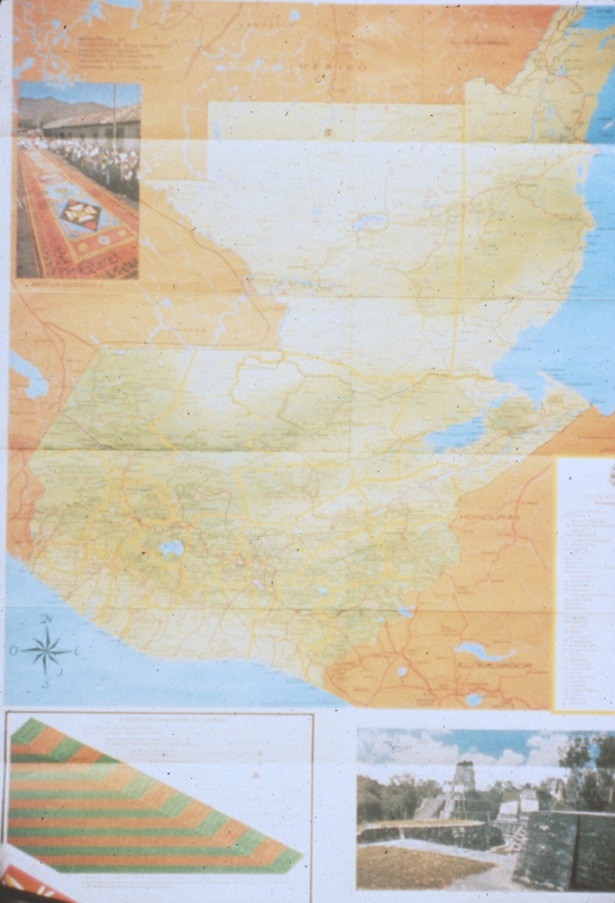
Notes:
The northern surface topography of Guatemala consists of a limestone plain, the central portion is covered by a limestone mountain range, and the southern portion is volcanic.

Slide 4
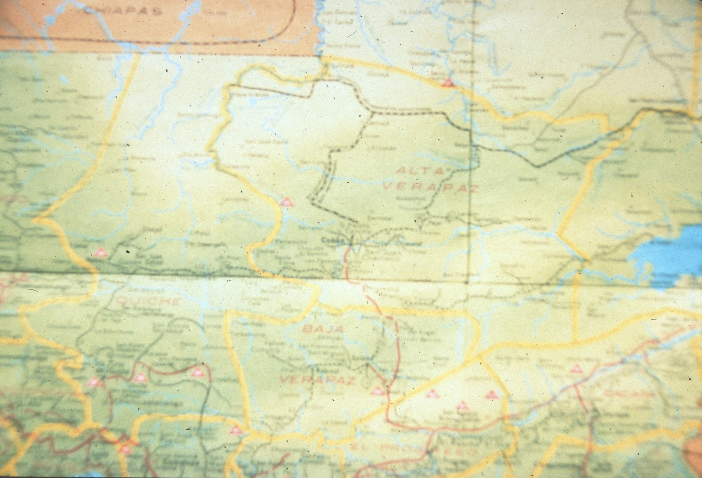
Notes:
The Lost World Expeditions concentrated their efforts on the caves in the central mountains near Coban.

Slide 5
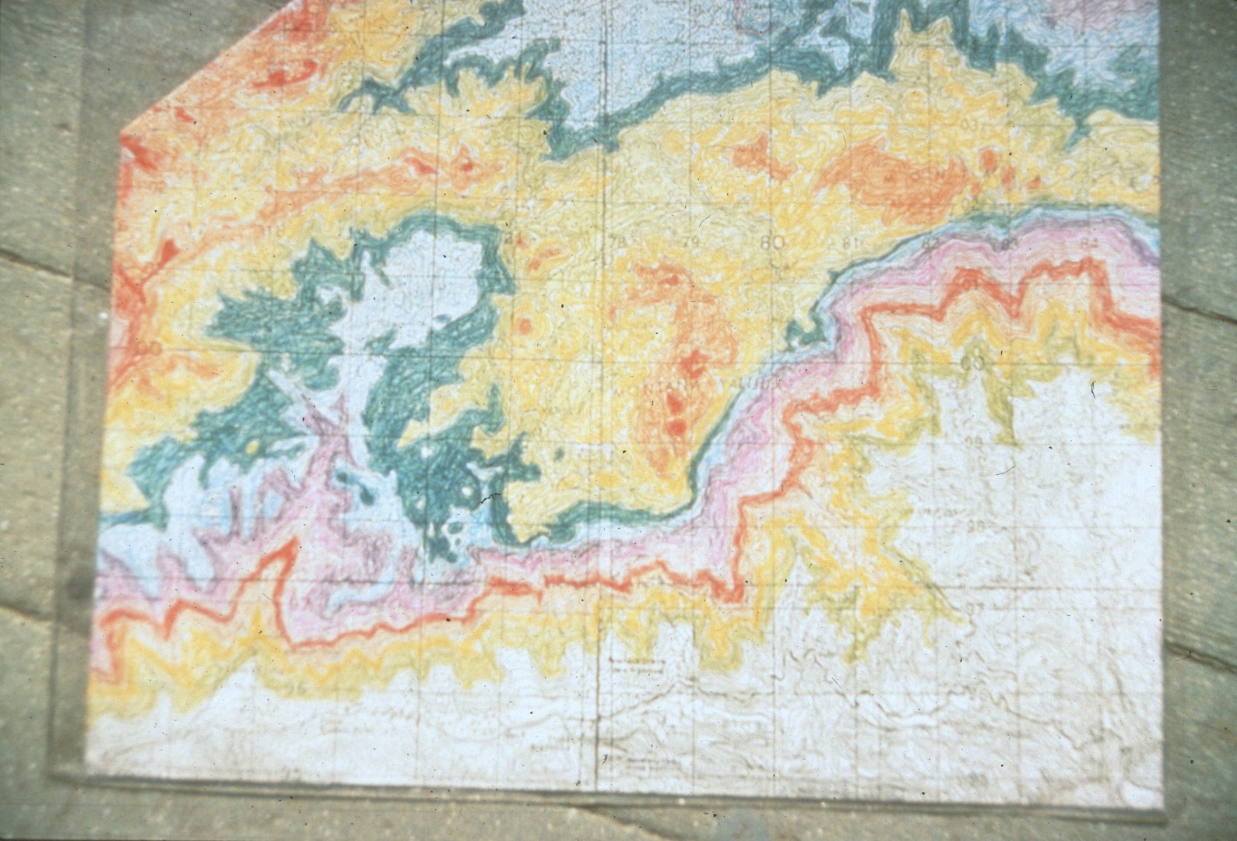
Notes:
The caves are located near an escarpment which runs east-west. The elevation of the western end of the escarpment approaches 12,500 feet above sea level. The caving area is located at about 5,000 feet above sea level, but the surface elevation quickly drops 1,000 feet within a mile or so.

Slide 6
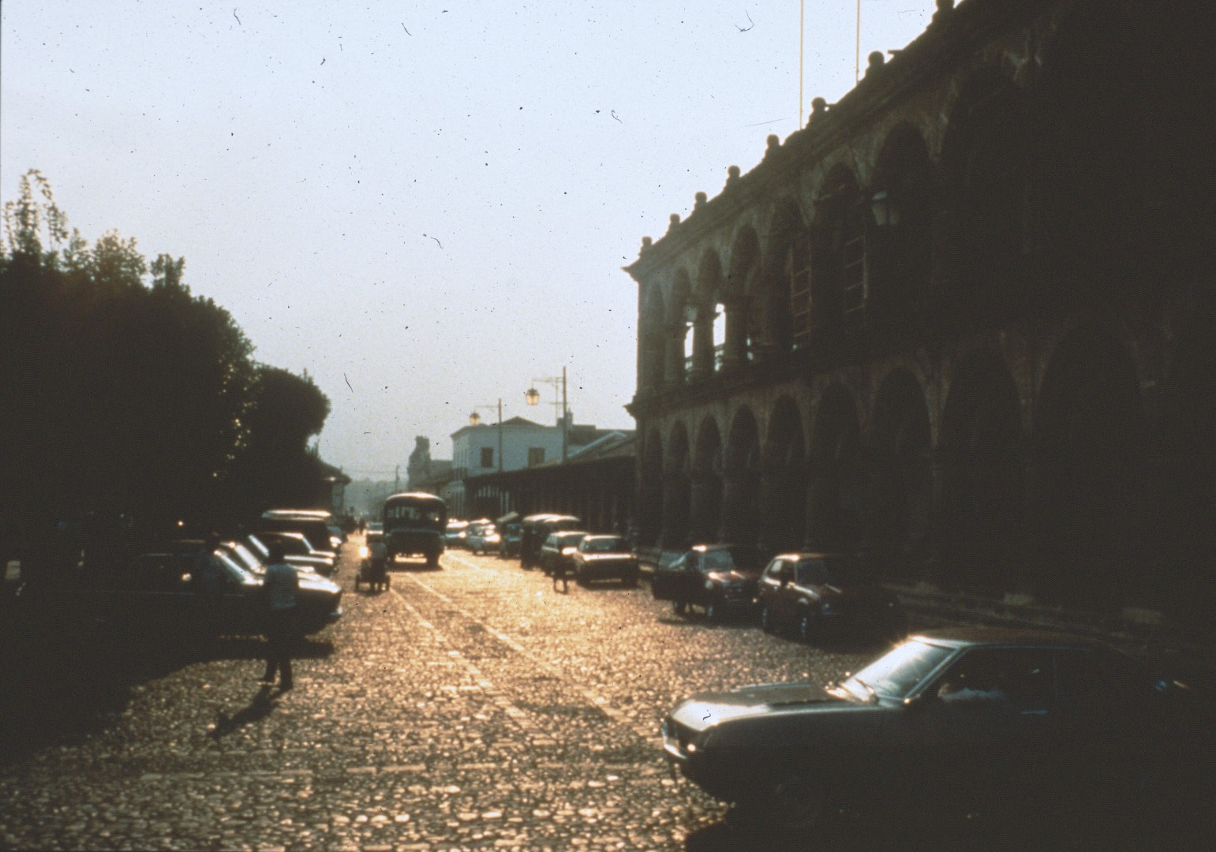
Notes:
The cavers flew into Guatemala City, then drove a short distance to Antigua, the old capital, to get ready for their trips into the mountains.

Slide 7
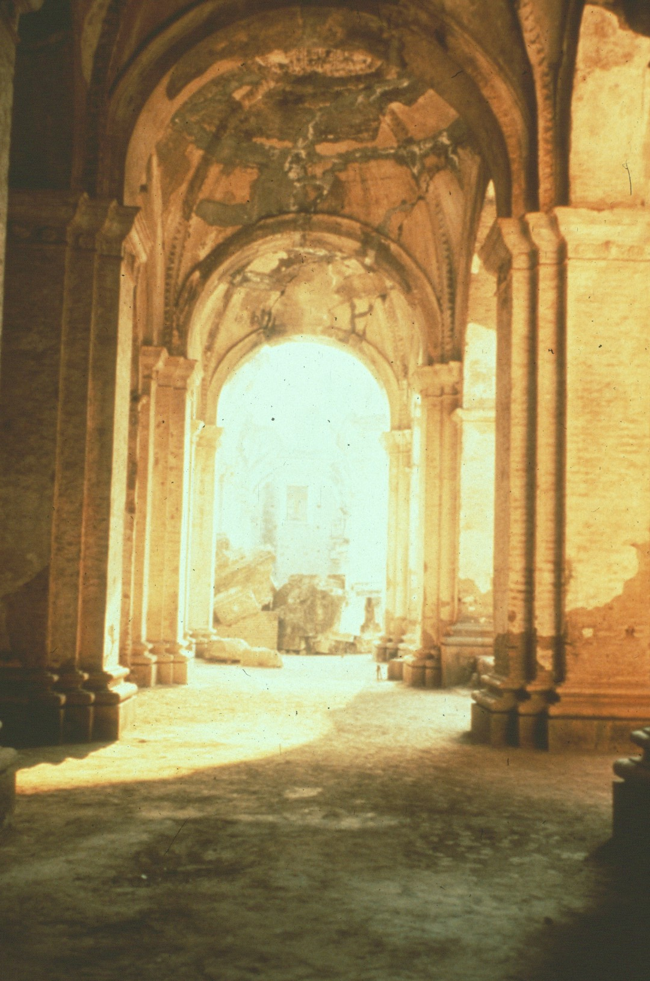
Notes:
The ruins of several old churches provided evidence of past earthquakes.

Slide 8
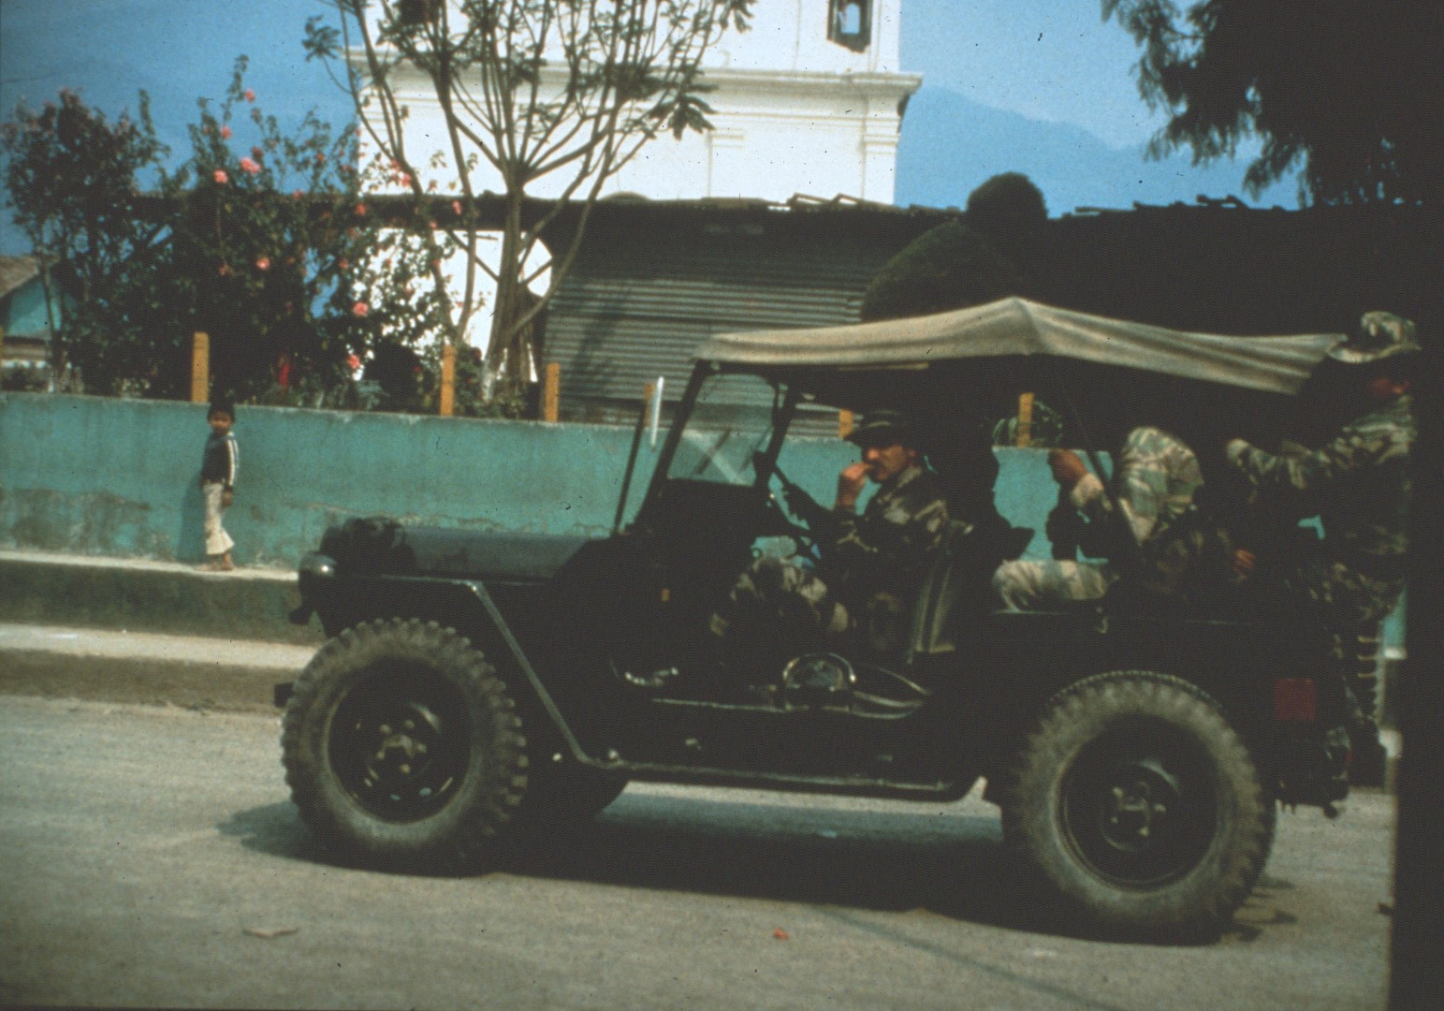
Notes:
The 1980’s were a period of civil unrest and military repression in Guatemala.

Slide 9
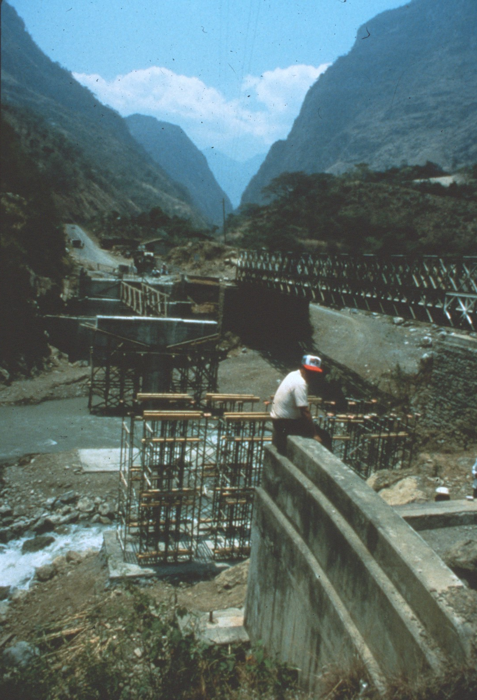
Notes:
During this period some of the bridges for the Pan American highway were destroyed by rebels.

Slide 10
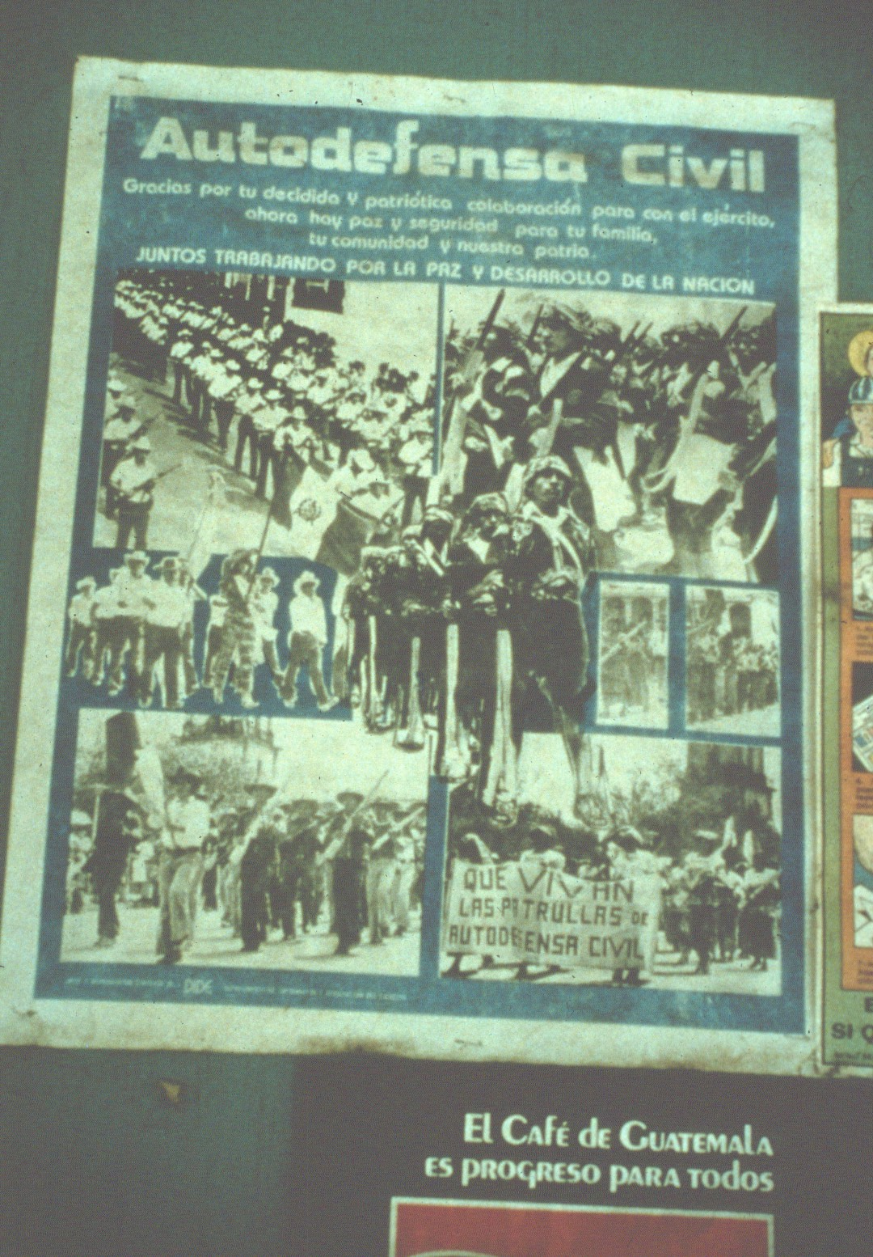
Notes:
Many regions formed local militia to combat the rebels. With so many people carrying weapons, Guatemala was a place where cavers had to be very careful.

Slide 11
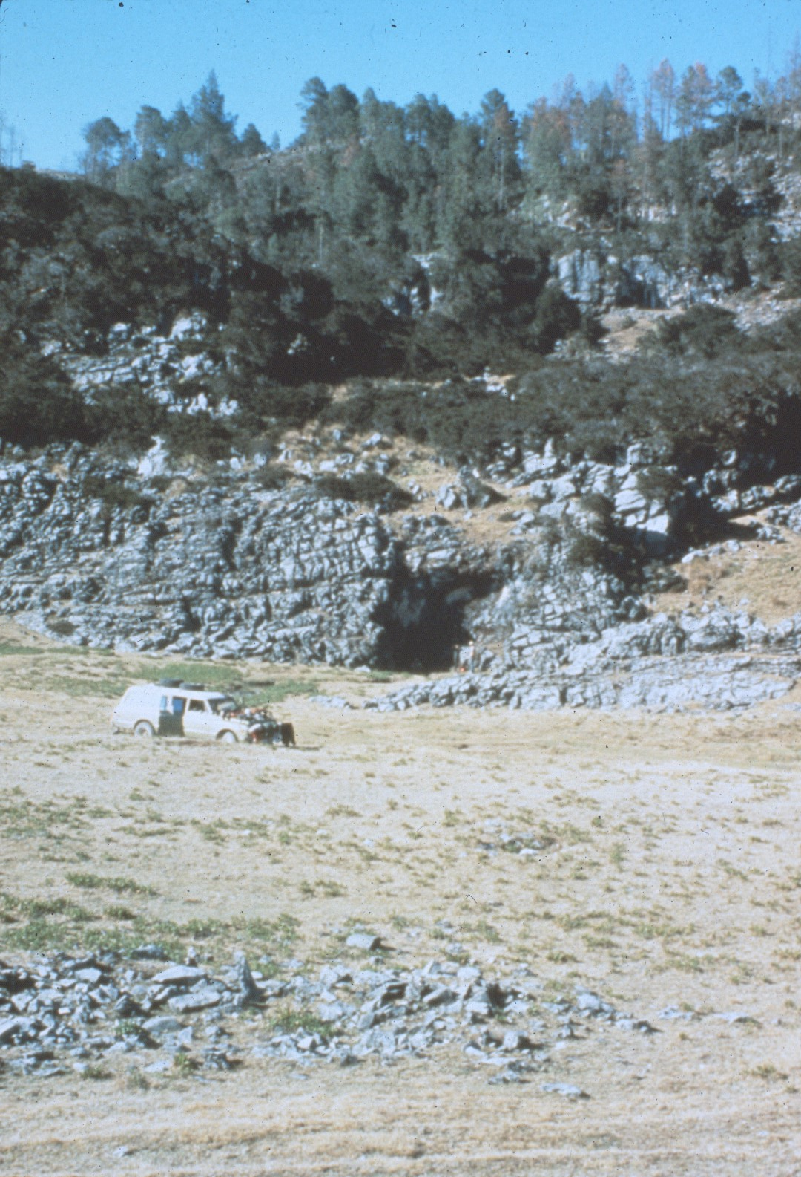
Notes:
During a trip in 1980, cavers stopped to explore a cave at 10,000 feet elevation in the mountains to the west of the primary caving area. The trip was aborted when they found a dead body inside the cave and were hassled by locals who wanted to know why they were there.”

Slide 12
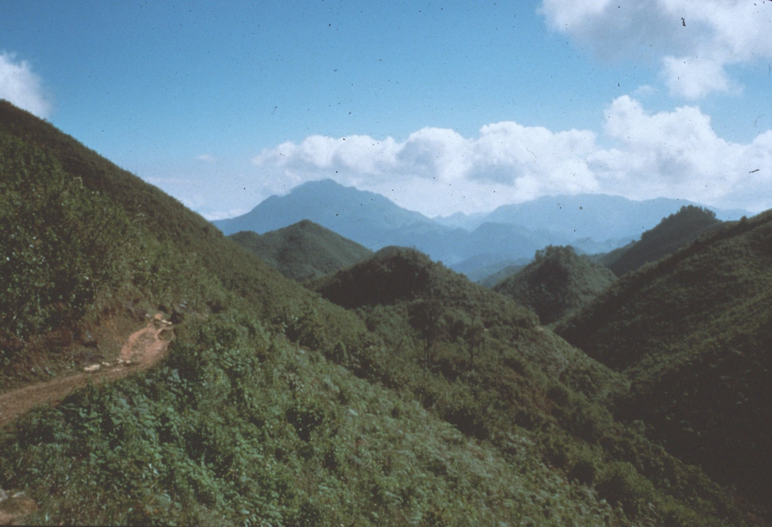
Notes:
Starting in 1987, cavers began to explore the primary caving area to be covered by this program.

Slide 13
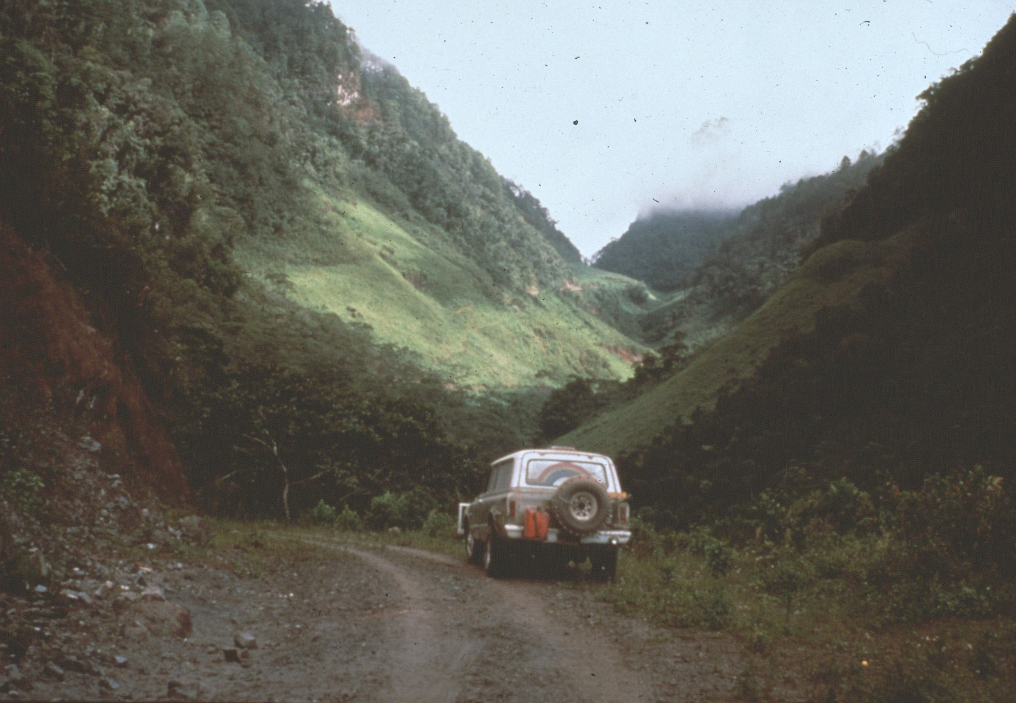
Notes:
The Yallehouch Valley is located high up in the central mountains near Coban.

Slide 14
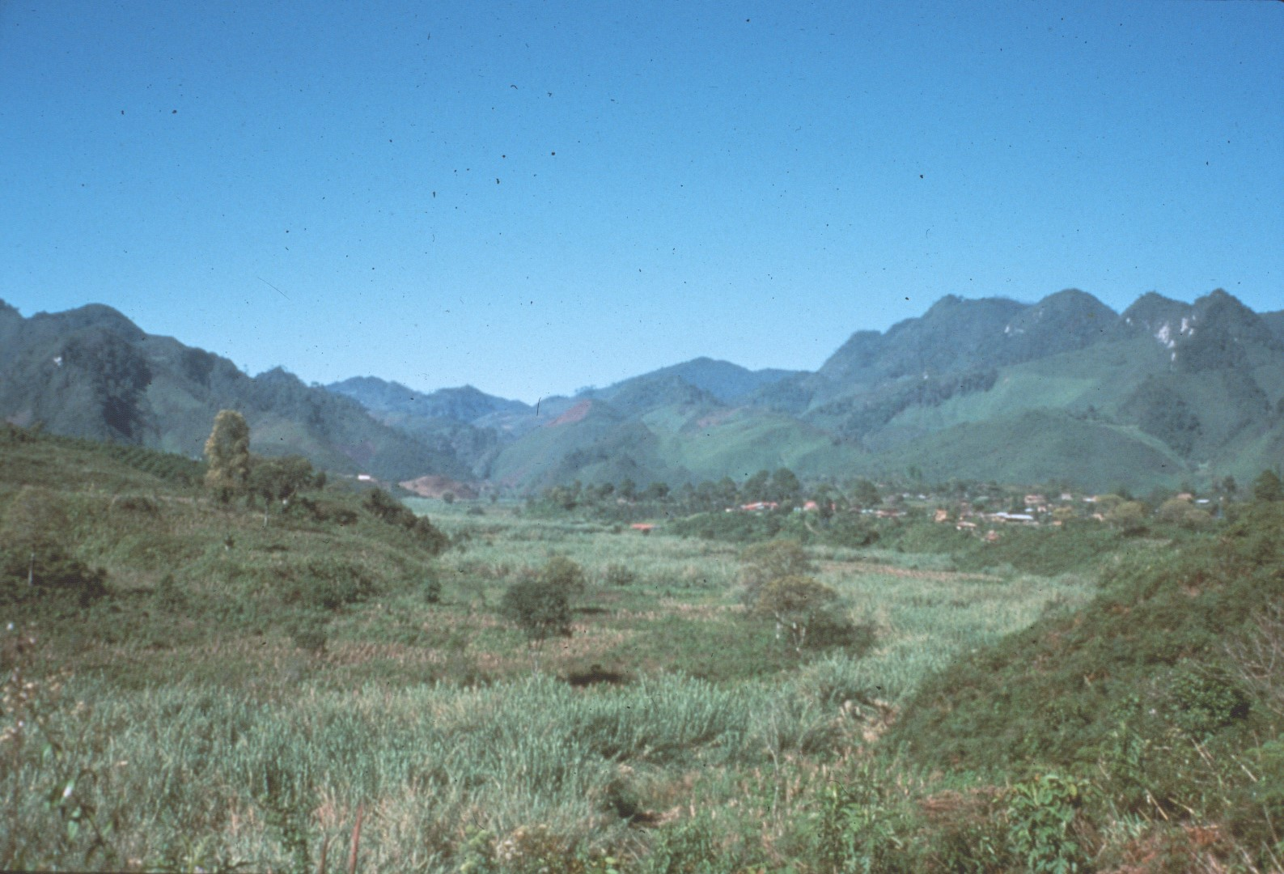
Notes:
It is a closed depression several miles long and a mile wide with a major stream that sinks in the floor of the valley.

Slide 15
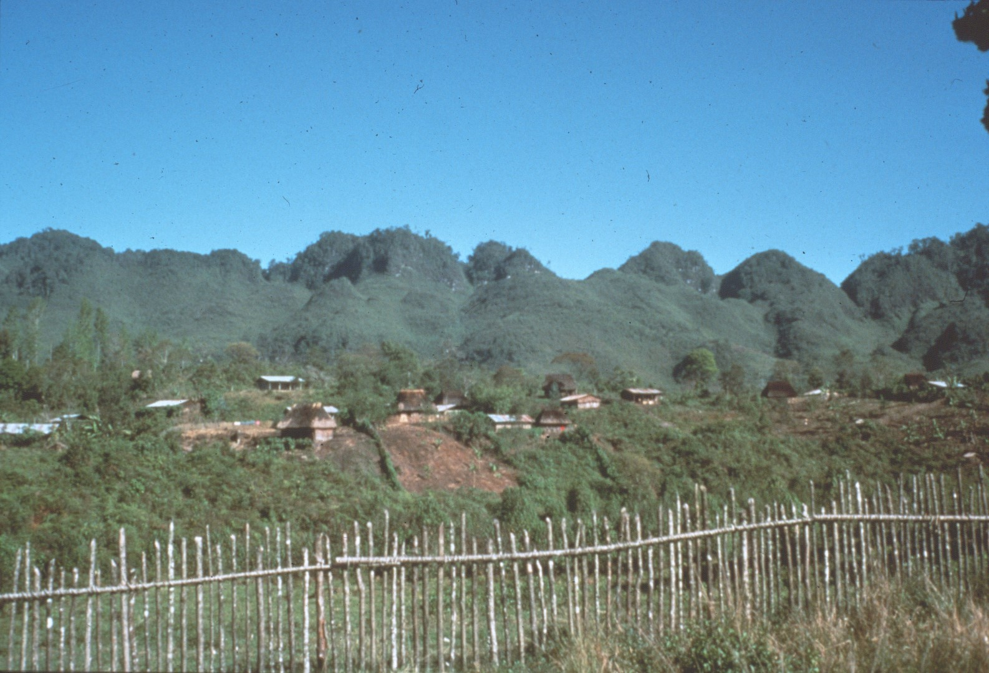
Notes:
Along one side of the valley is a communal town built by the government in the late 1980’s.

Slide 16
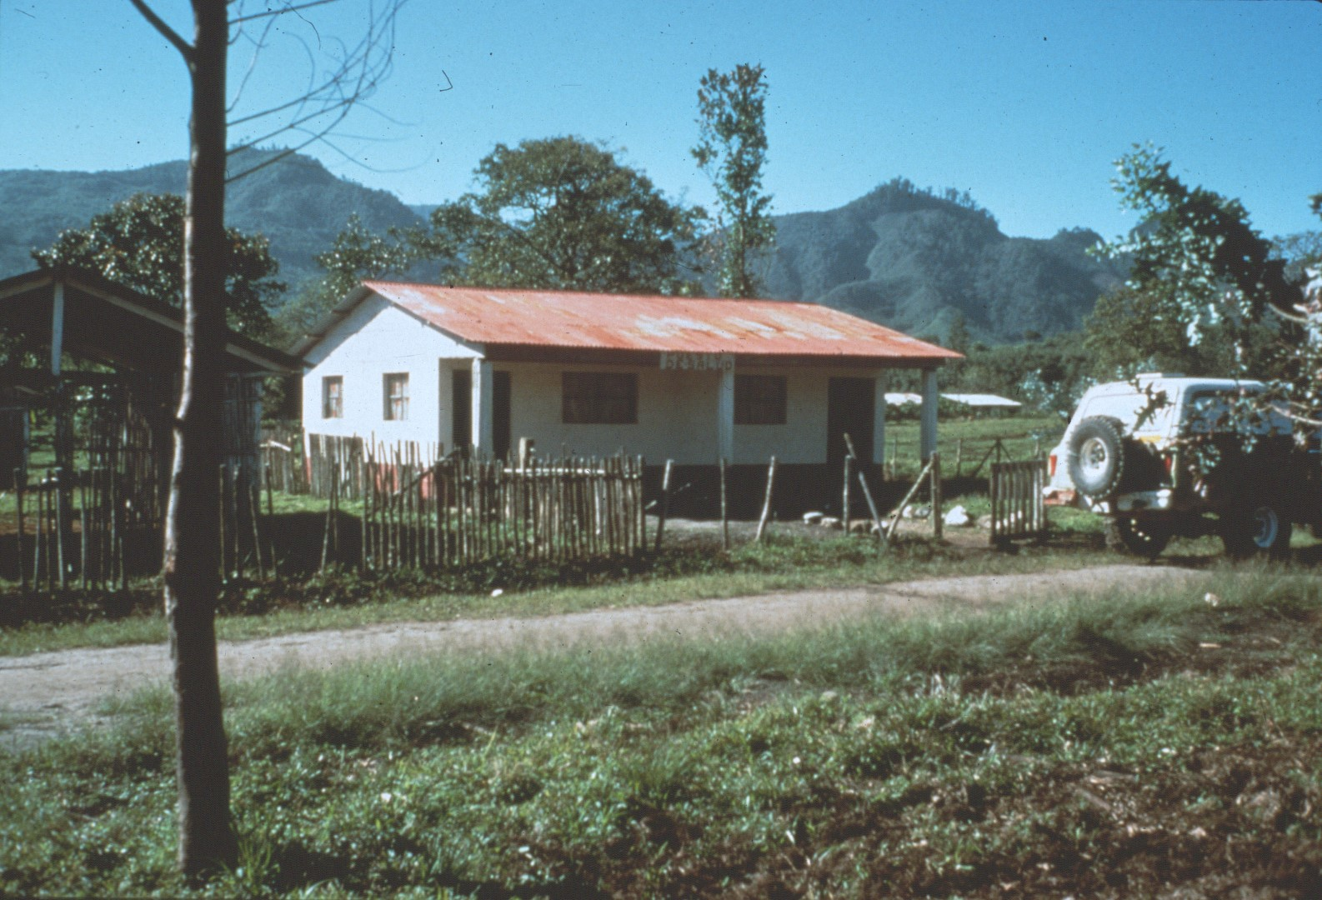
Notes:
The caver accommodations in this area was an empty health station building which was never staffed by the government.

Slide 17
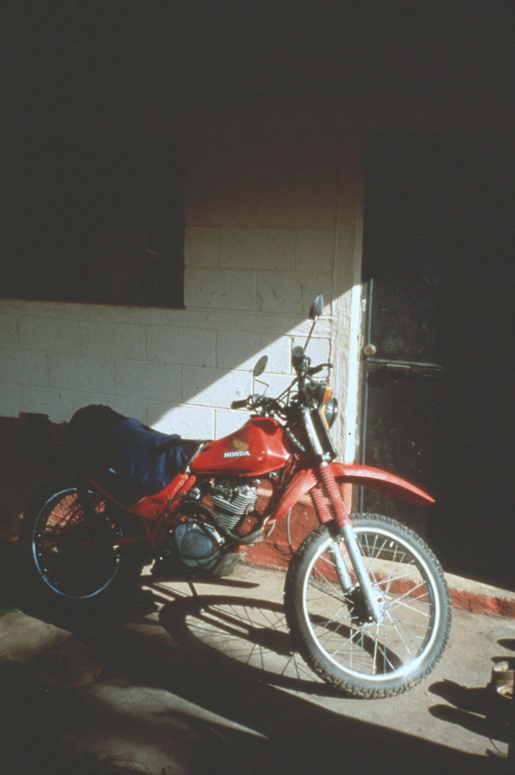
Notes:
They rented a truck to get their gear up to the health station at the end of the road, then drove the truck back to town to avoid paying rental fees while they were caving. Once they brought a motorcycle intending to use it after they returned the truck, but the roads proved to be too rough.

Slide 18
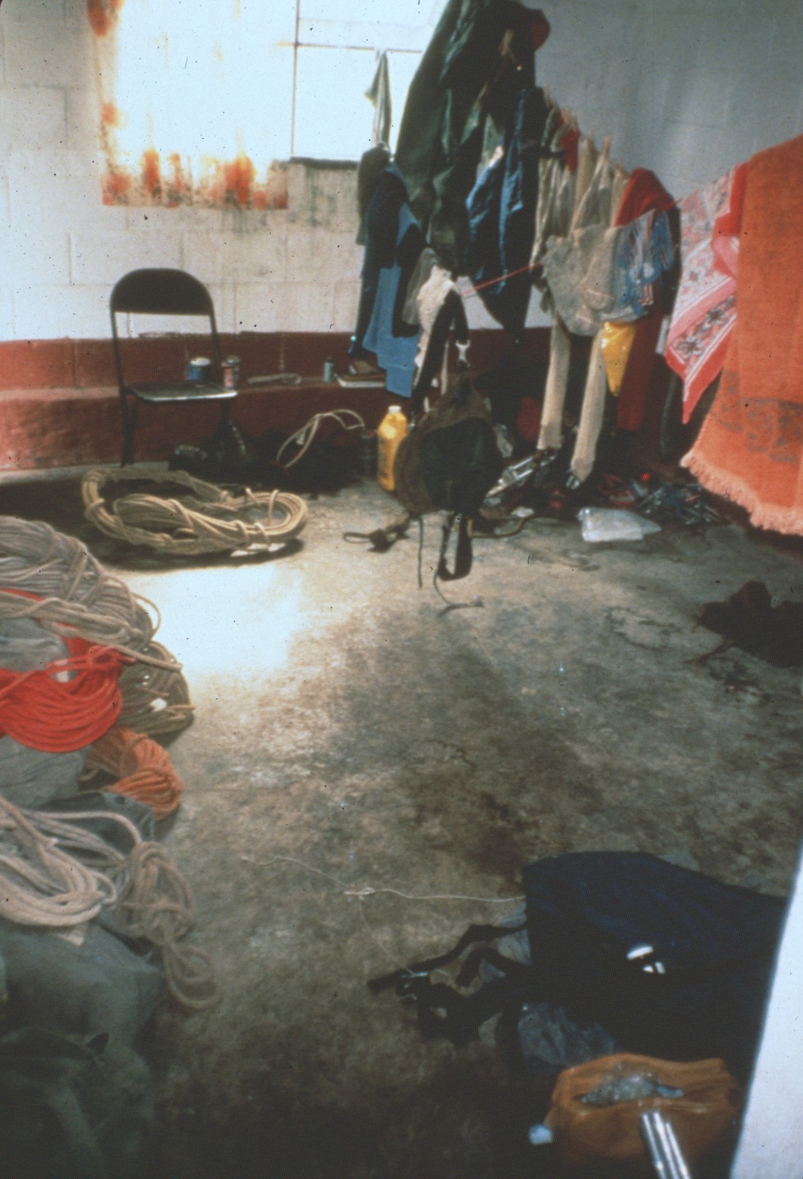
Notes:
The health station was an excellent base of operations.

Slide 19
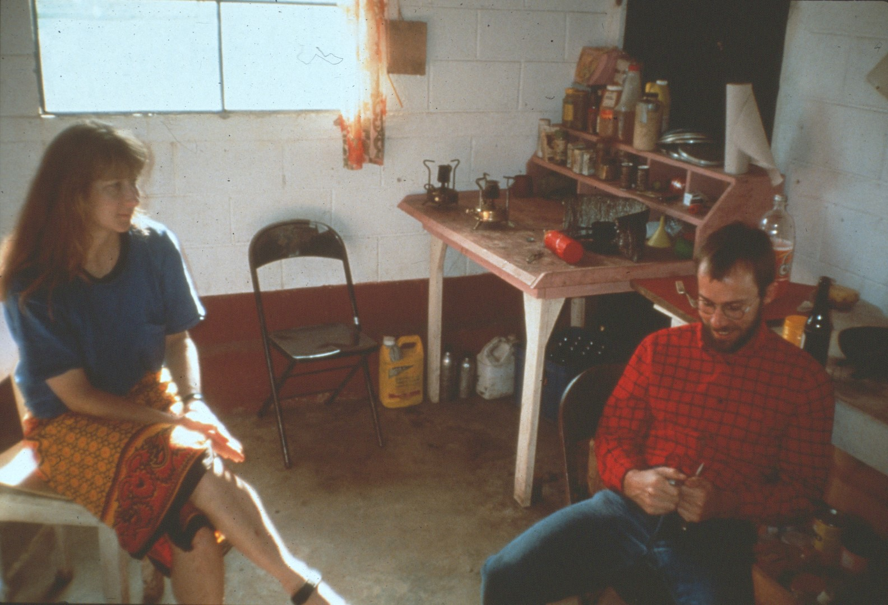
Notes:
It came equipped with a few tables, and the cavers brought chairs.

Slide 20
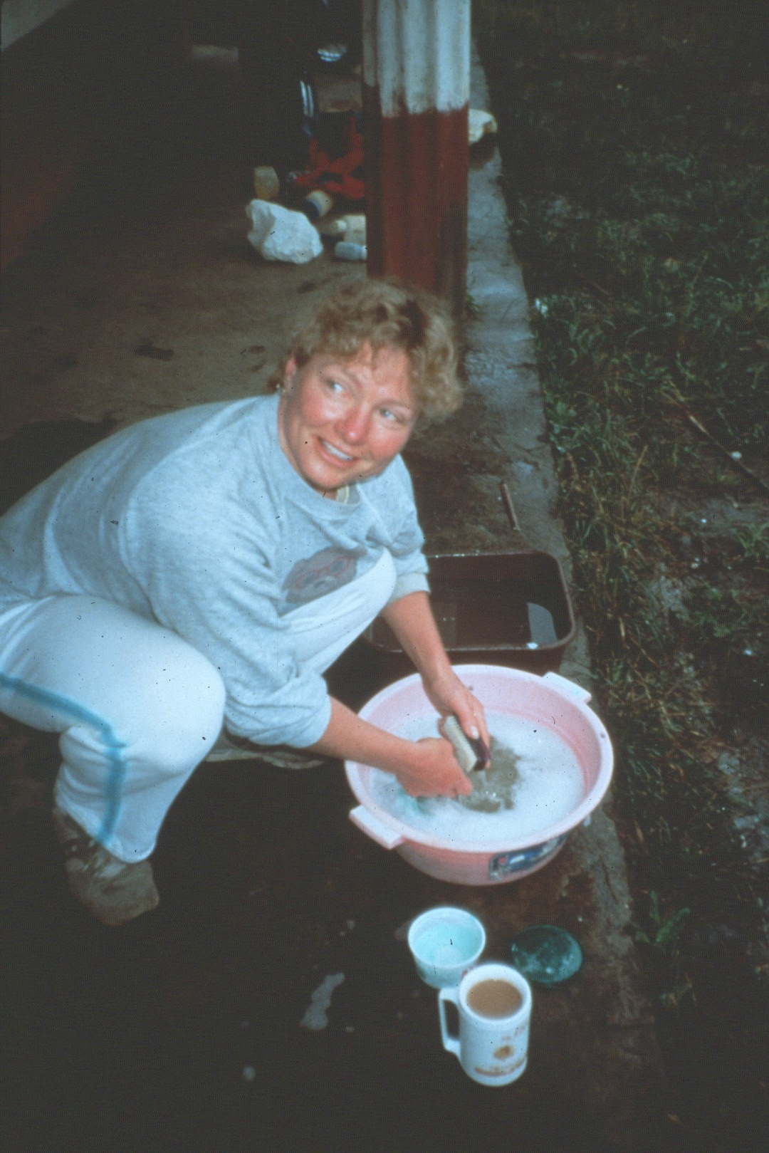
Notes:
Everyone shared in the communal chores, such as washing dishes and …

Slide 21
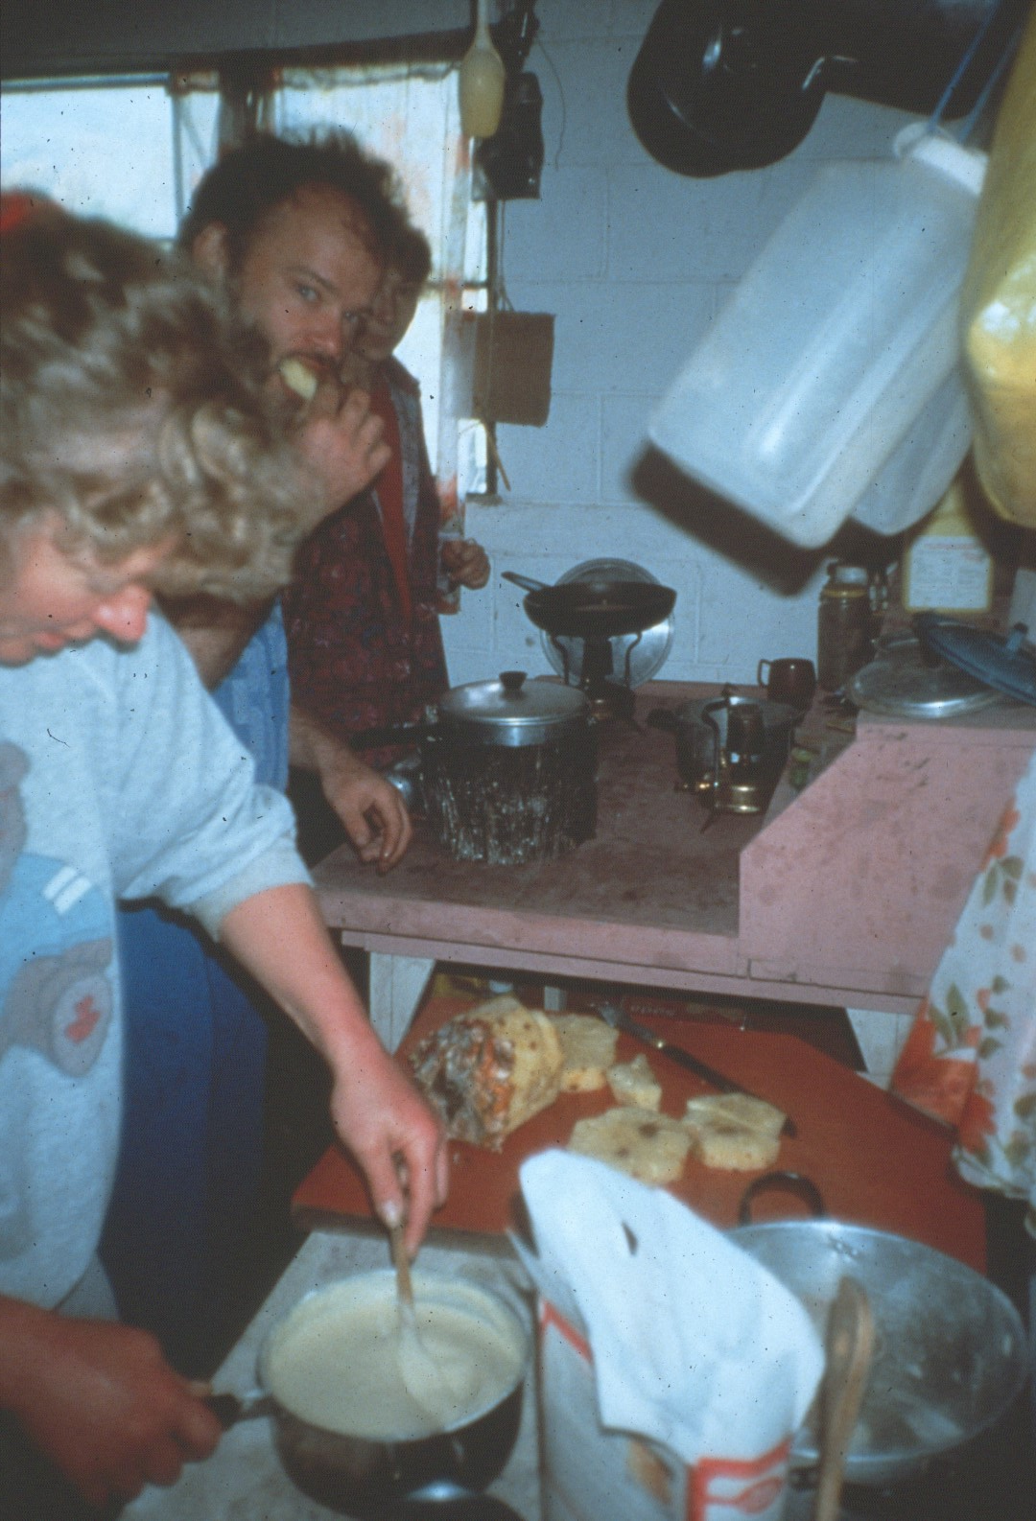
Notes:
Cooking meals.

Slide 22
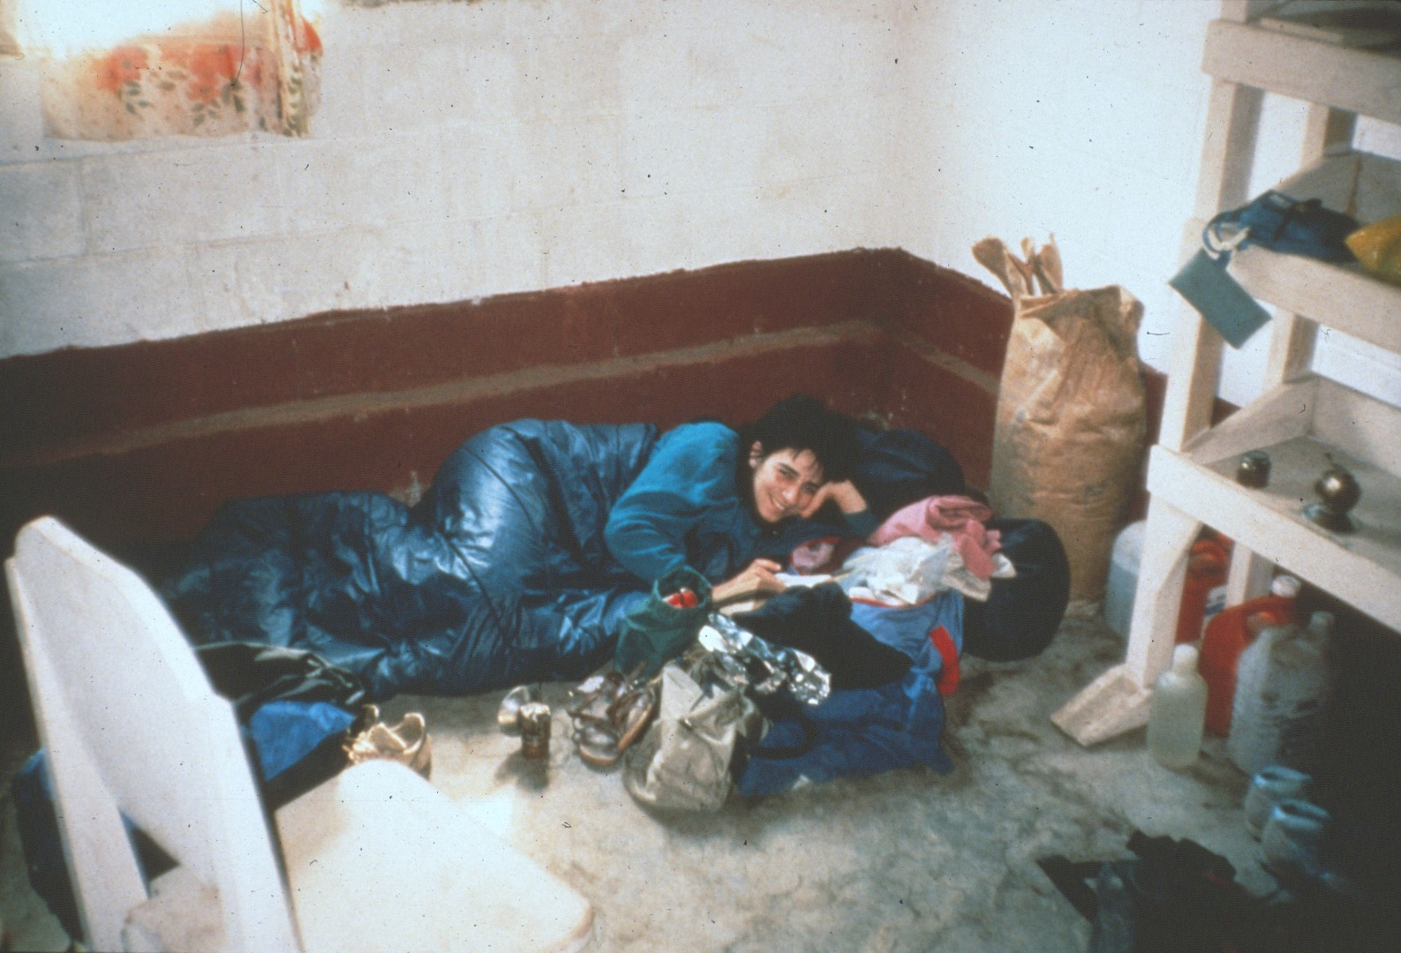
Notes:
While some cavers slept in the house, …

Slide 23
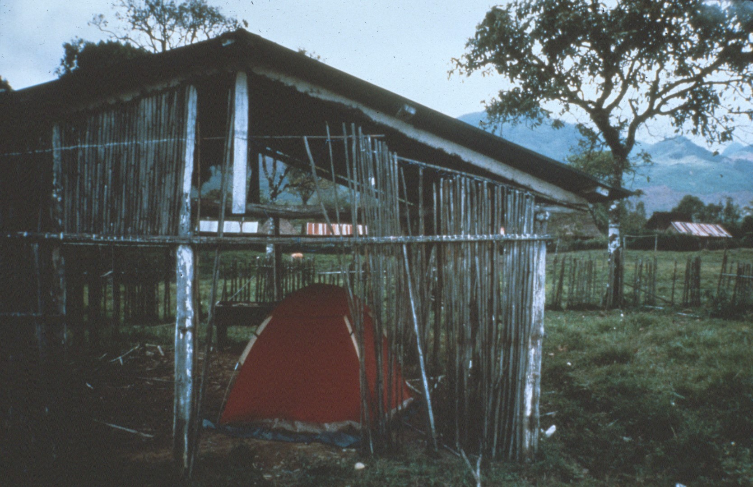
Notes:
Others slept in tents, …

Slide 24
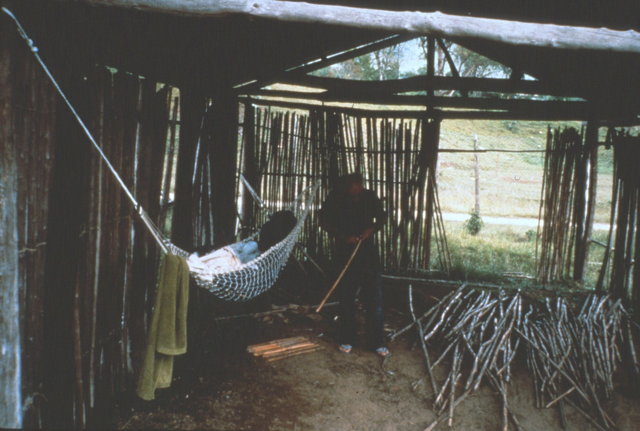
Notes:
Or hammocks in an adjacent structure. The weather was fairly cold, and it commonly rained once or twice each week. On the plus side there were no mosquitos and none of the nasty insects typically found in the lowlands of Central America.

Slide 25
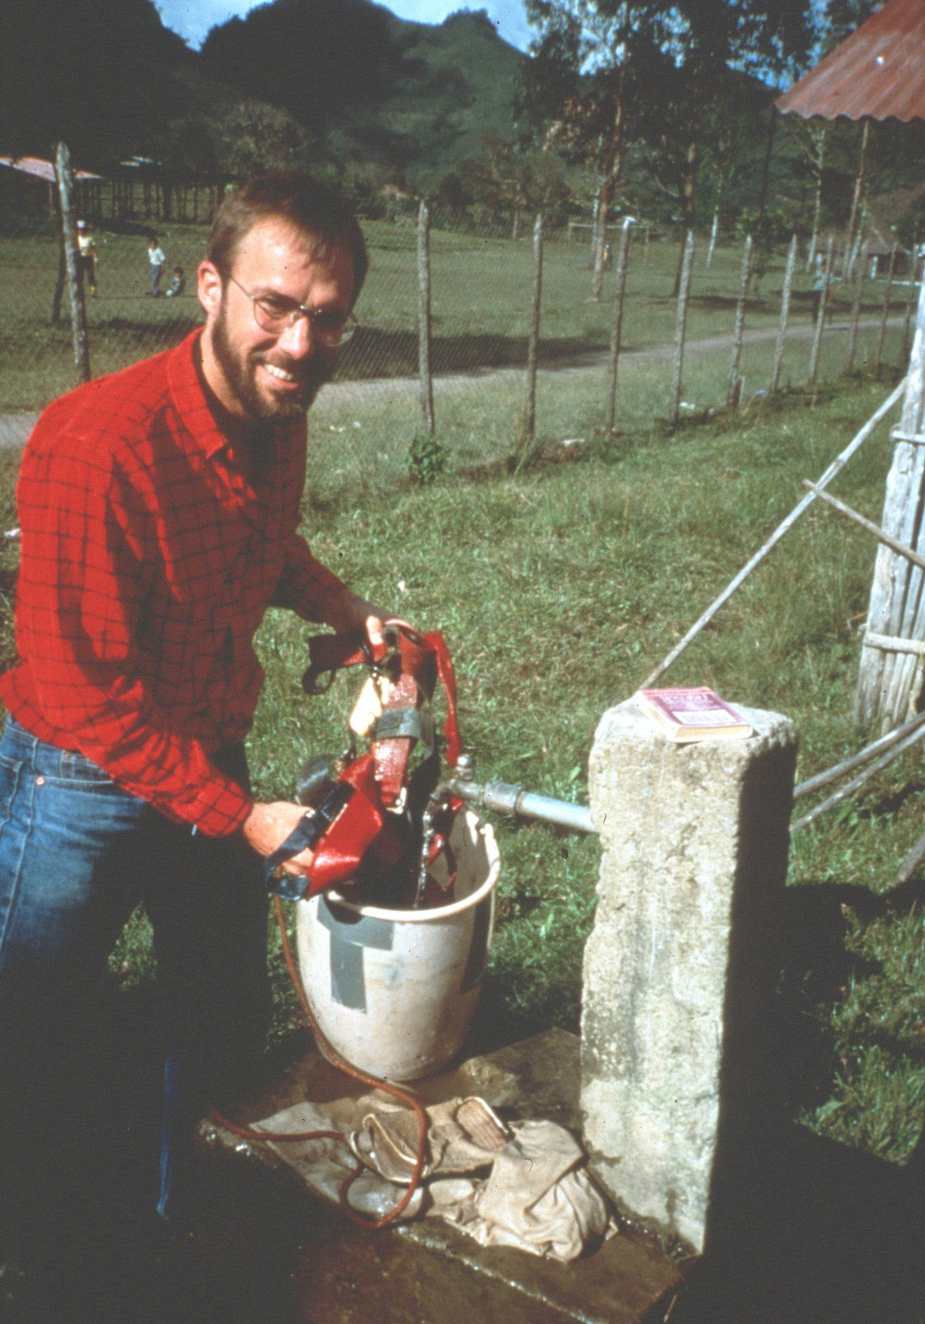
Notes:
The government installed a water system when they built the town and one of the spigots was just outside the health center.

Slide 26
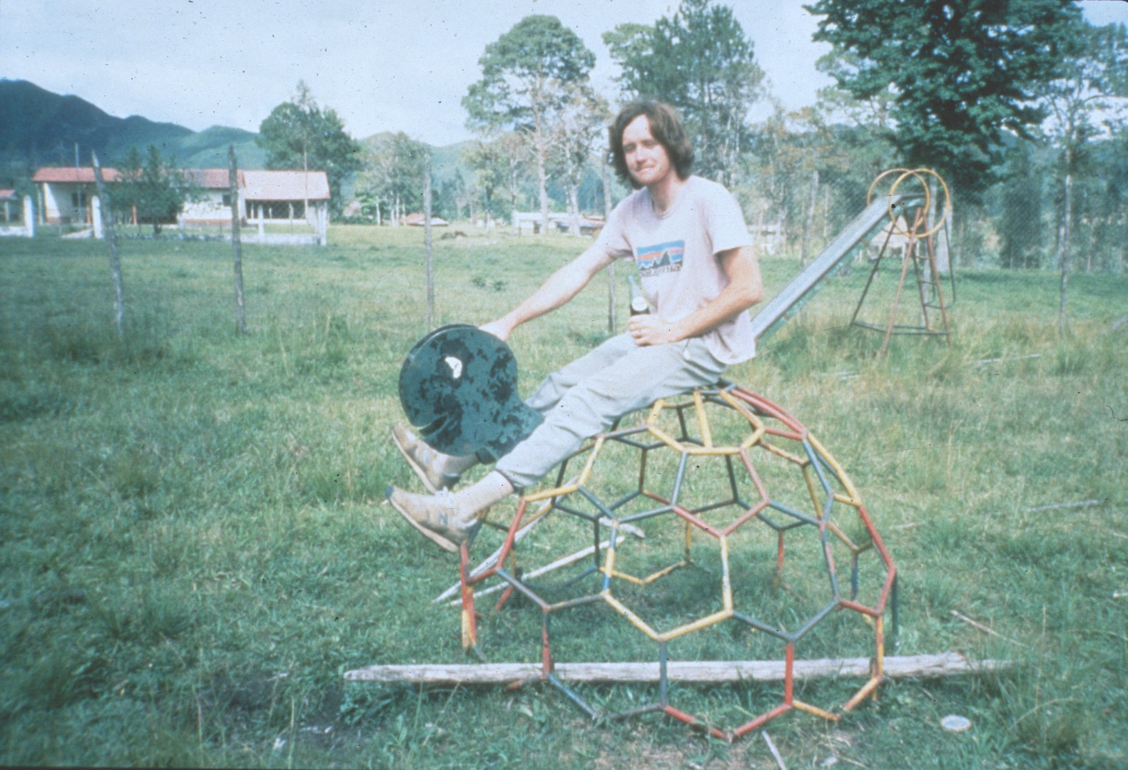
Notes:
Next door to the health center was a school, complete with playground.

Slide 27
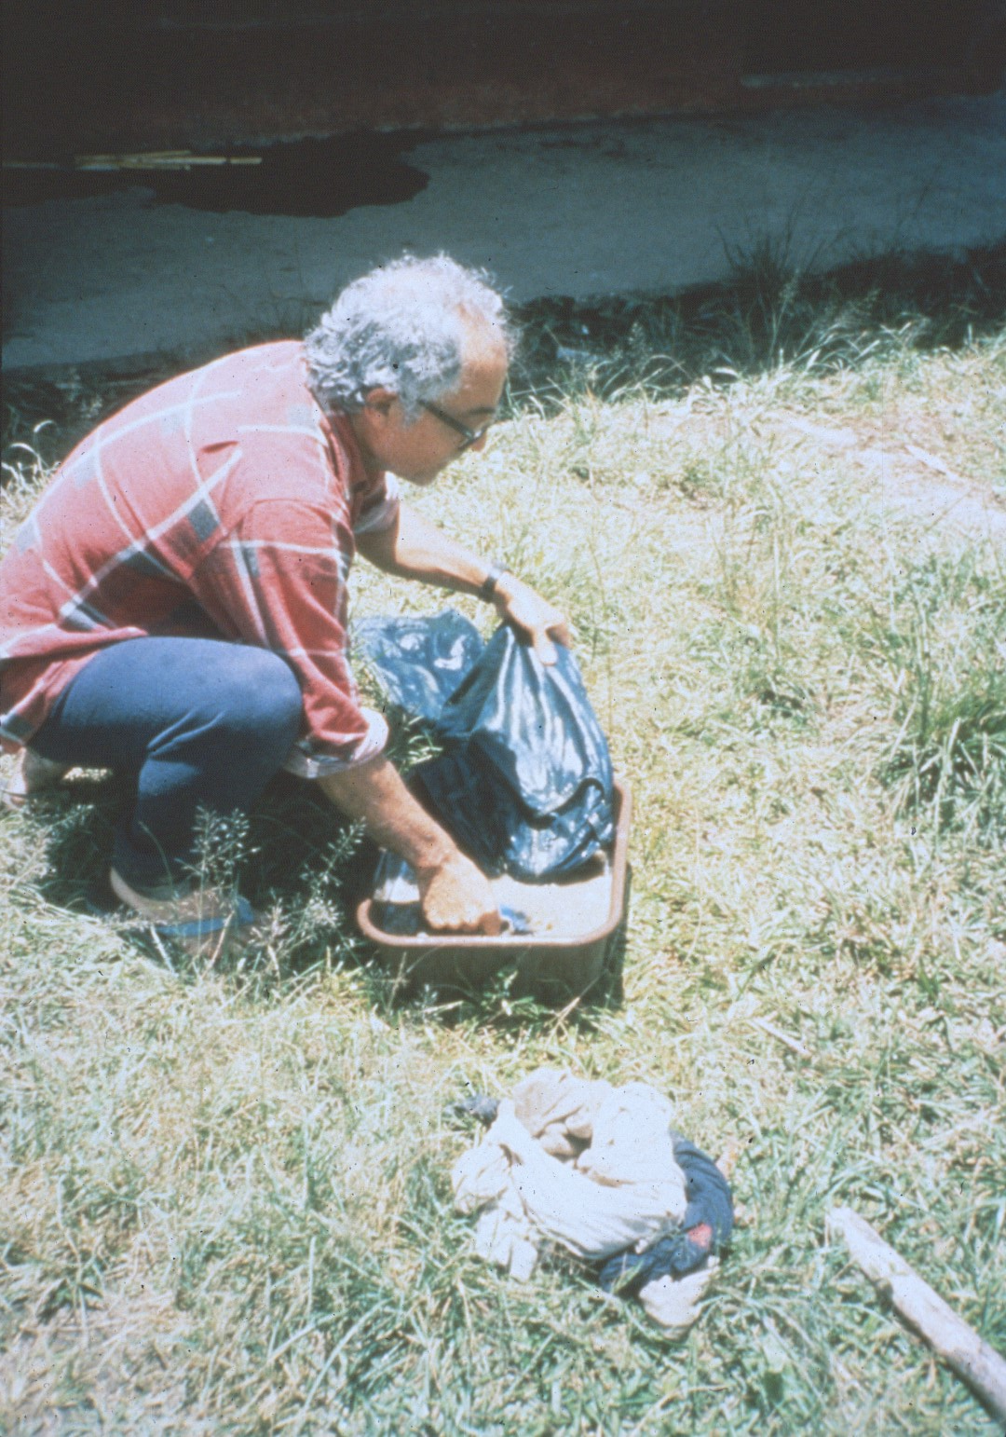
Notes:
All in all, it was a great place to repair gear, …

Slide 28
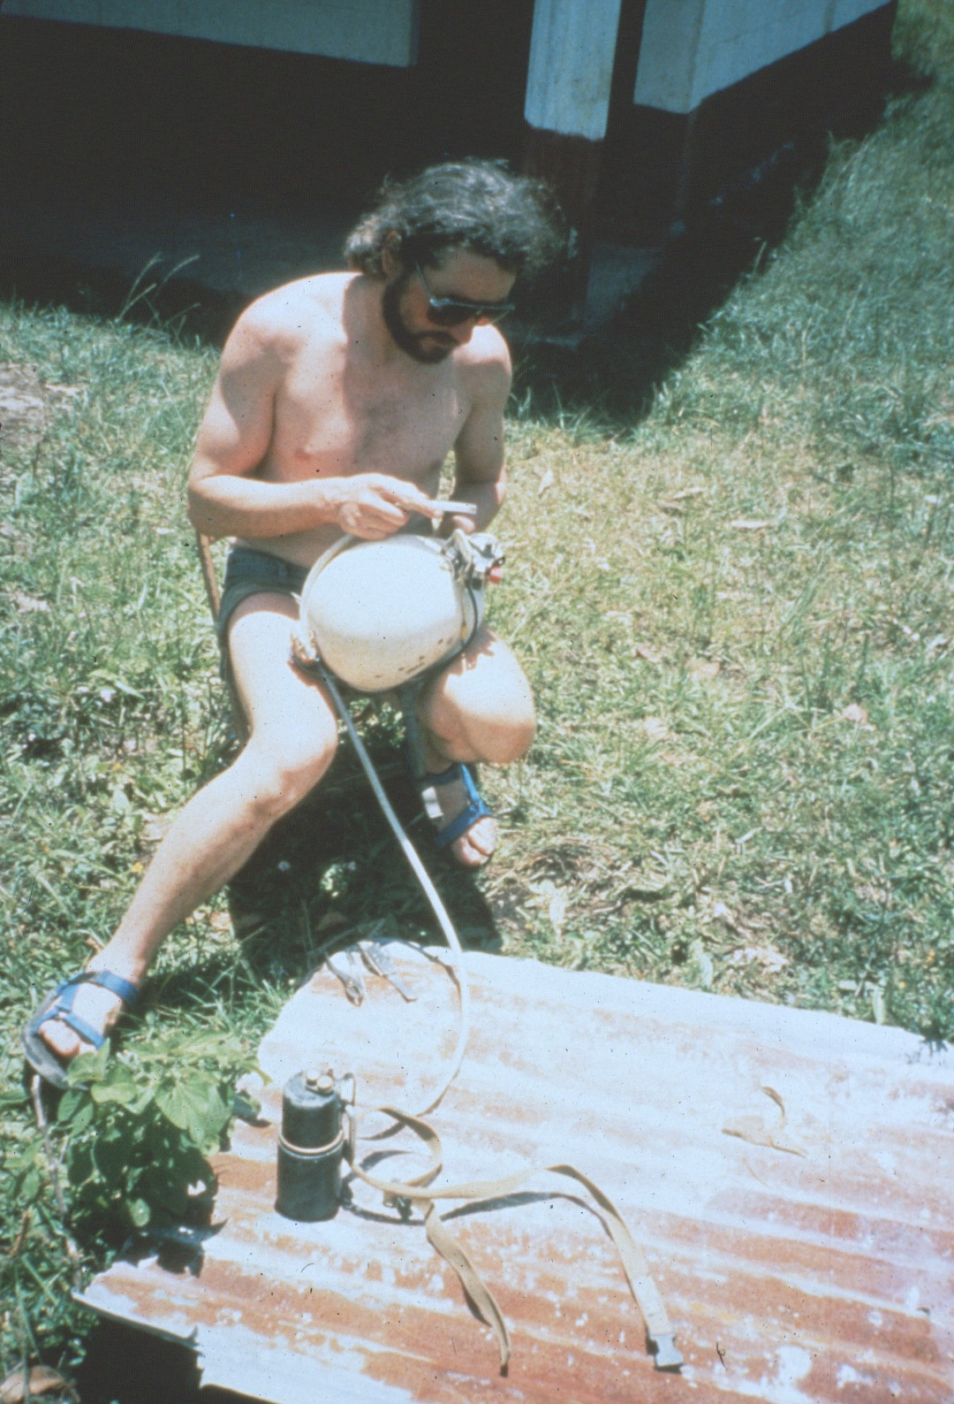
Notes:
And get ready for cave trips.

Slide 29
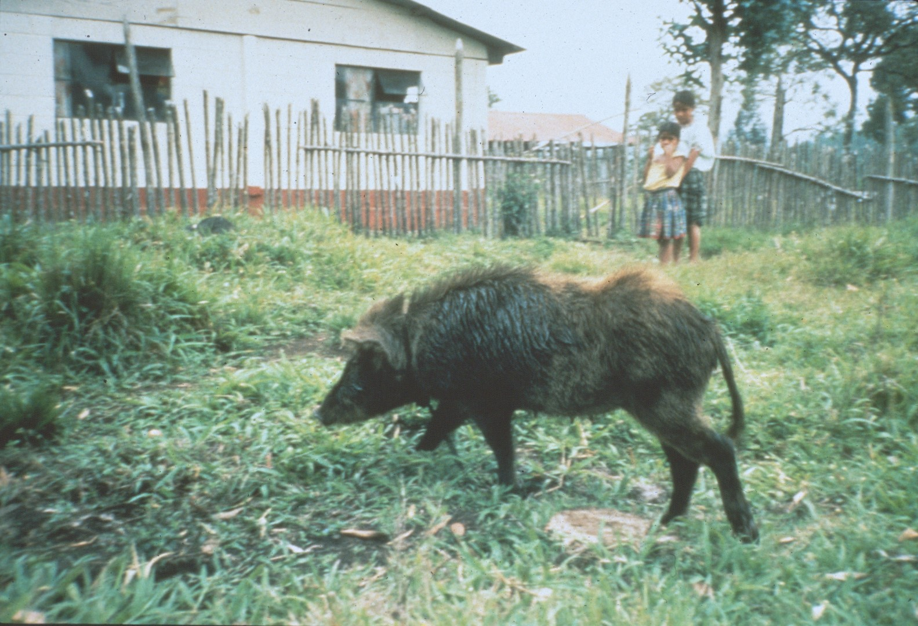
Notes:
It was not unusual for a wild pig to wander through the yard.

Slide 30
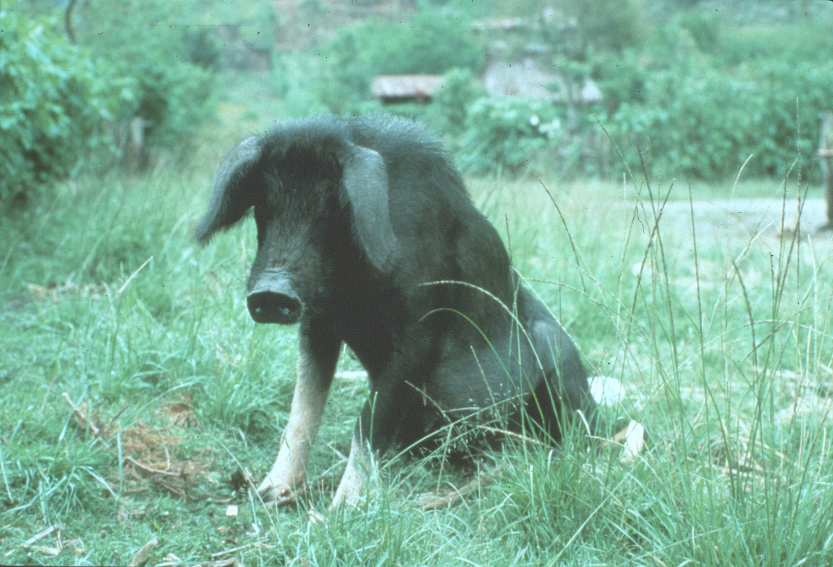
Notes:
They looked so mean that everyone let them sit wherever they wanted.

Slide 31
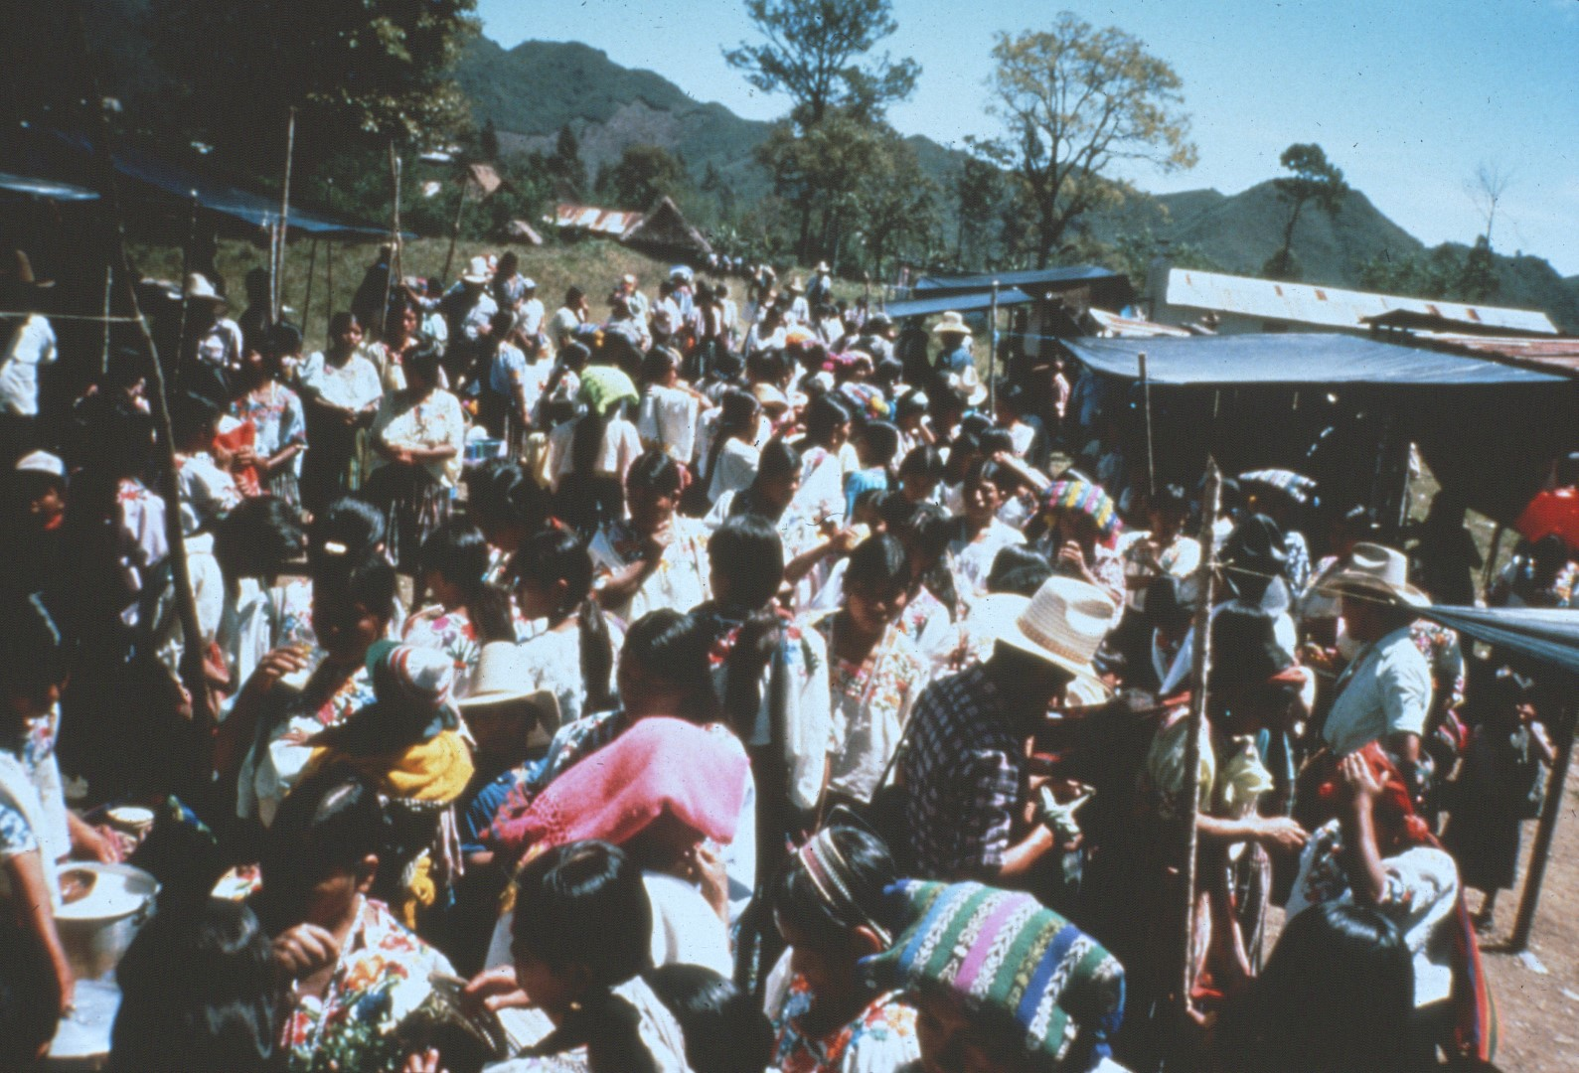
Notes:
While the town was small, it was quite busy during market day.

Slide 32
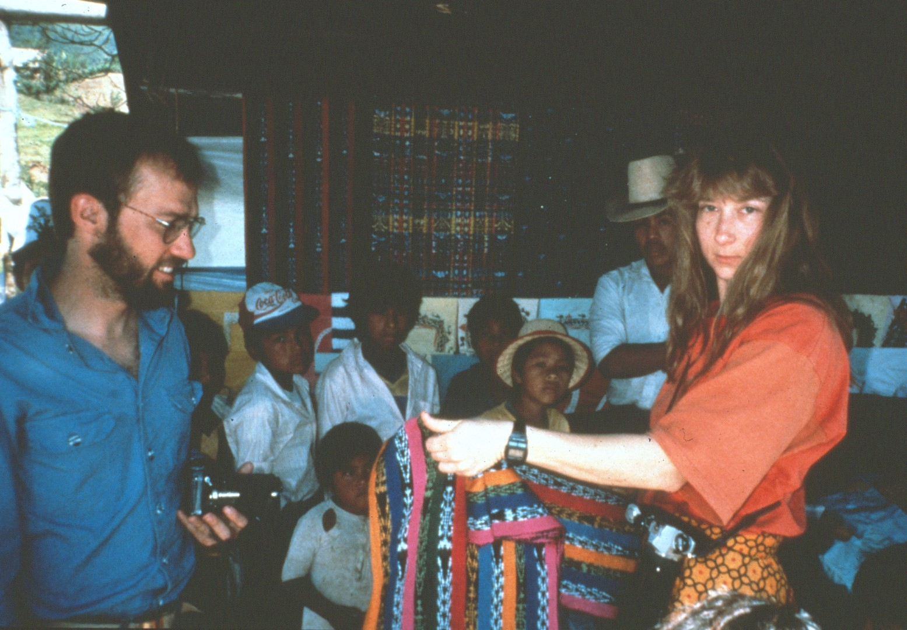
Notes:
The cavers shopped for souvenirs, …

Slide 33
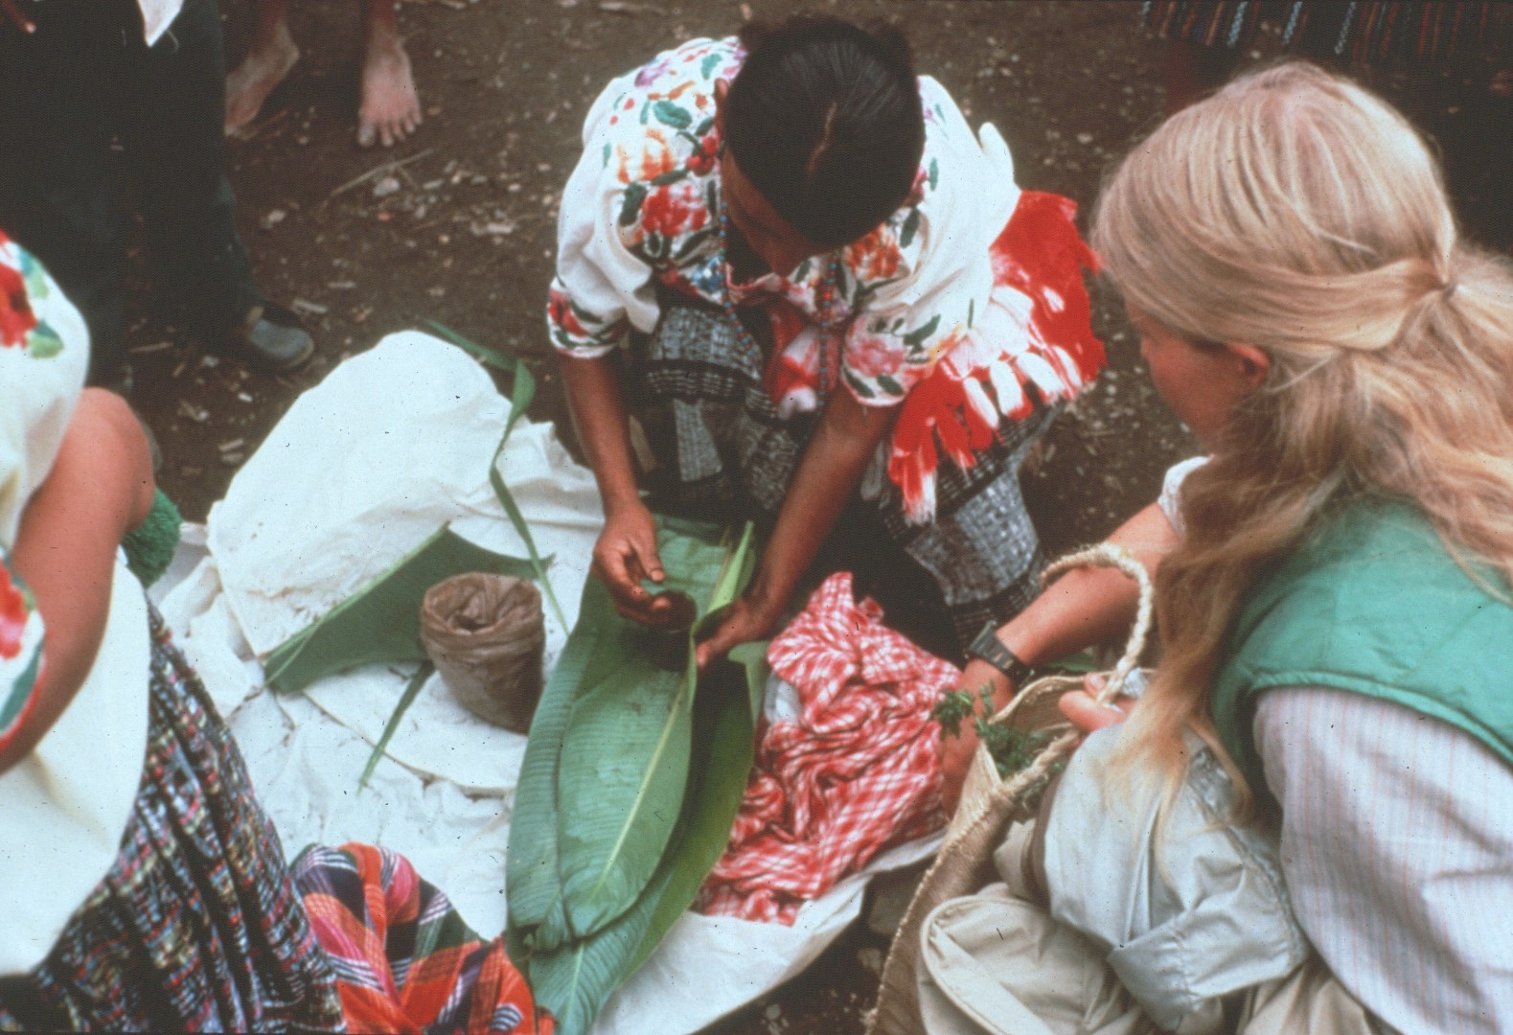
Notes:
Food, and coffee.

Slide 34
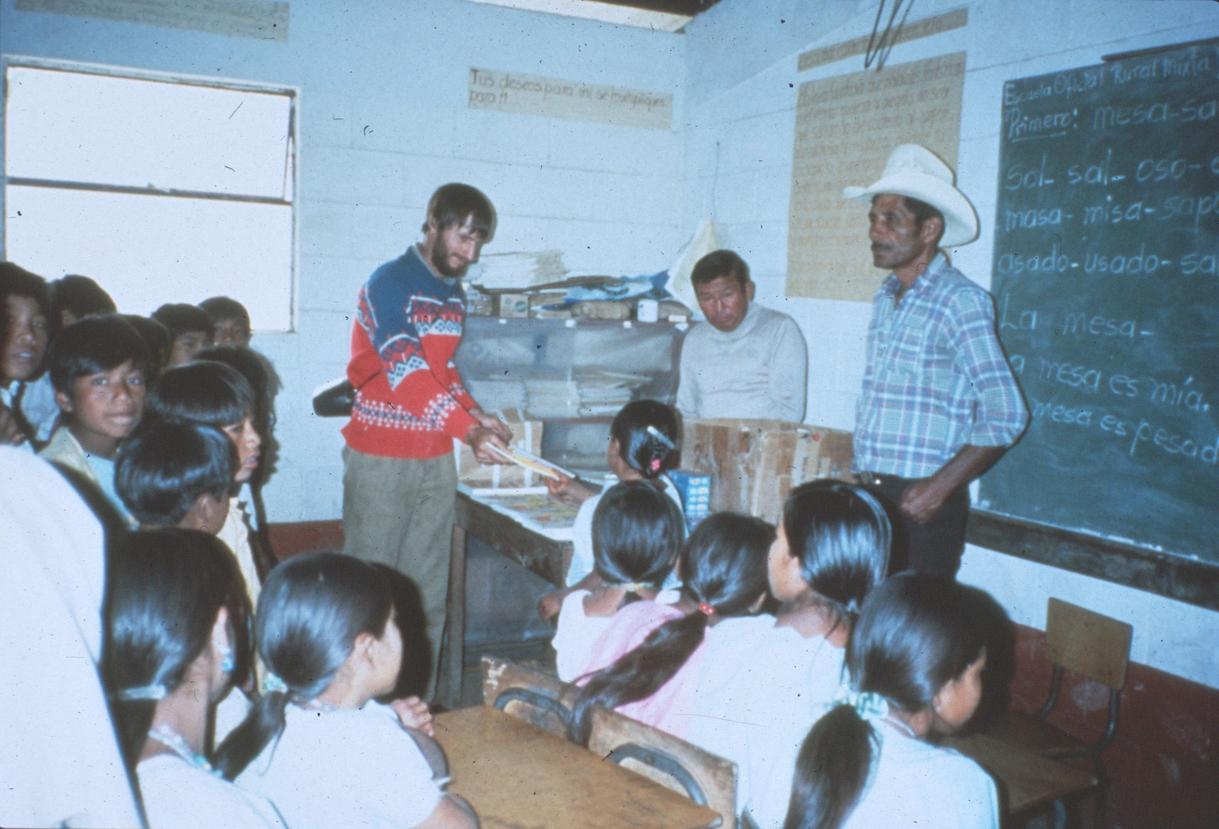
Notes:
Each year the cavers tried to hep toe local community in some way.

Slide 35
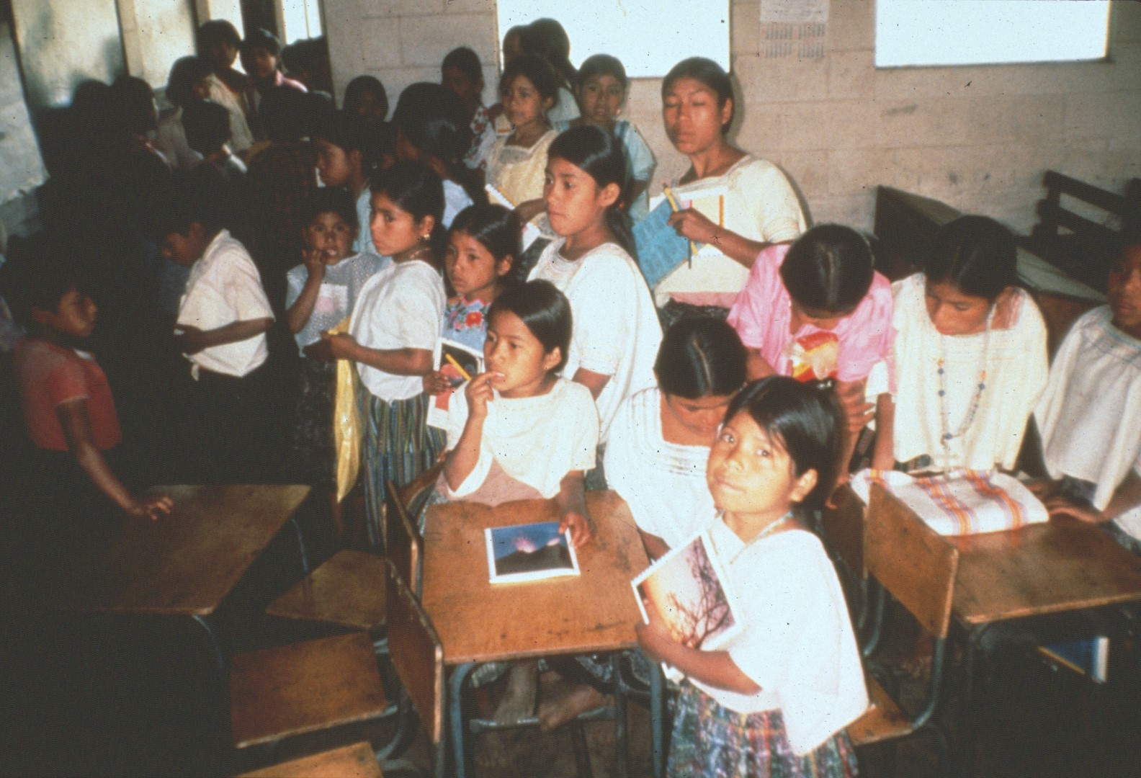
Notes:
One year they donated notebooks and pens to the students of the local school …

Slide 36
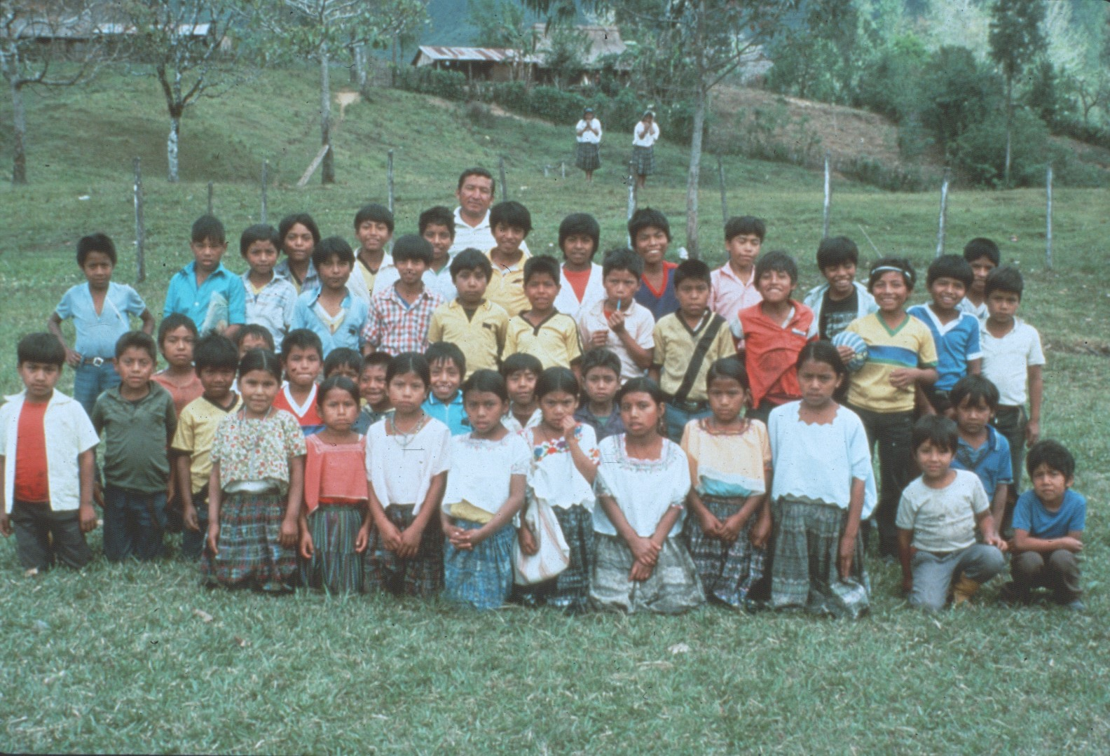
Notes:
And provided a picture of the class.

Slide 37
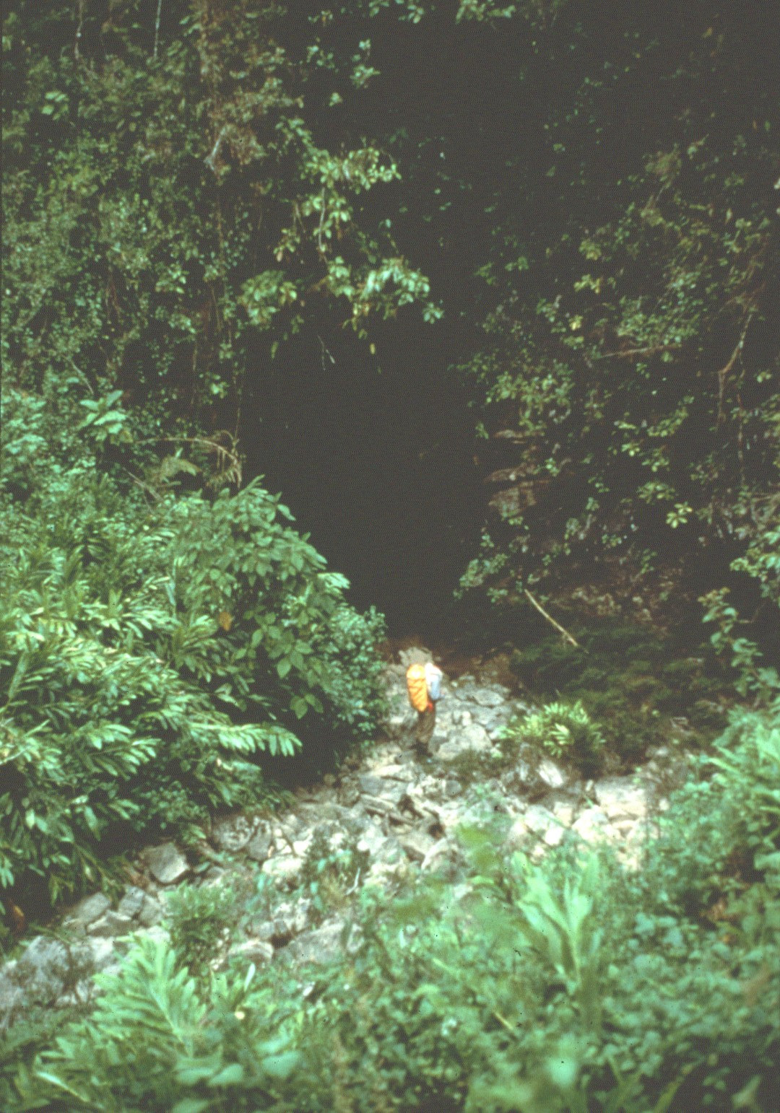
Notes:
There are several dry sumideros (stream beds) on the Yallehouch Valley floor that carry water in wet weather.

Slide 38
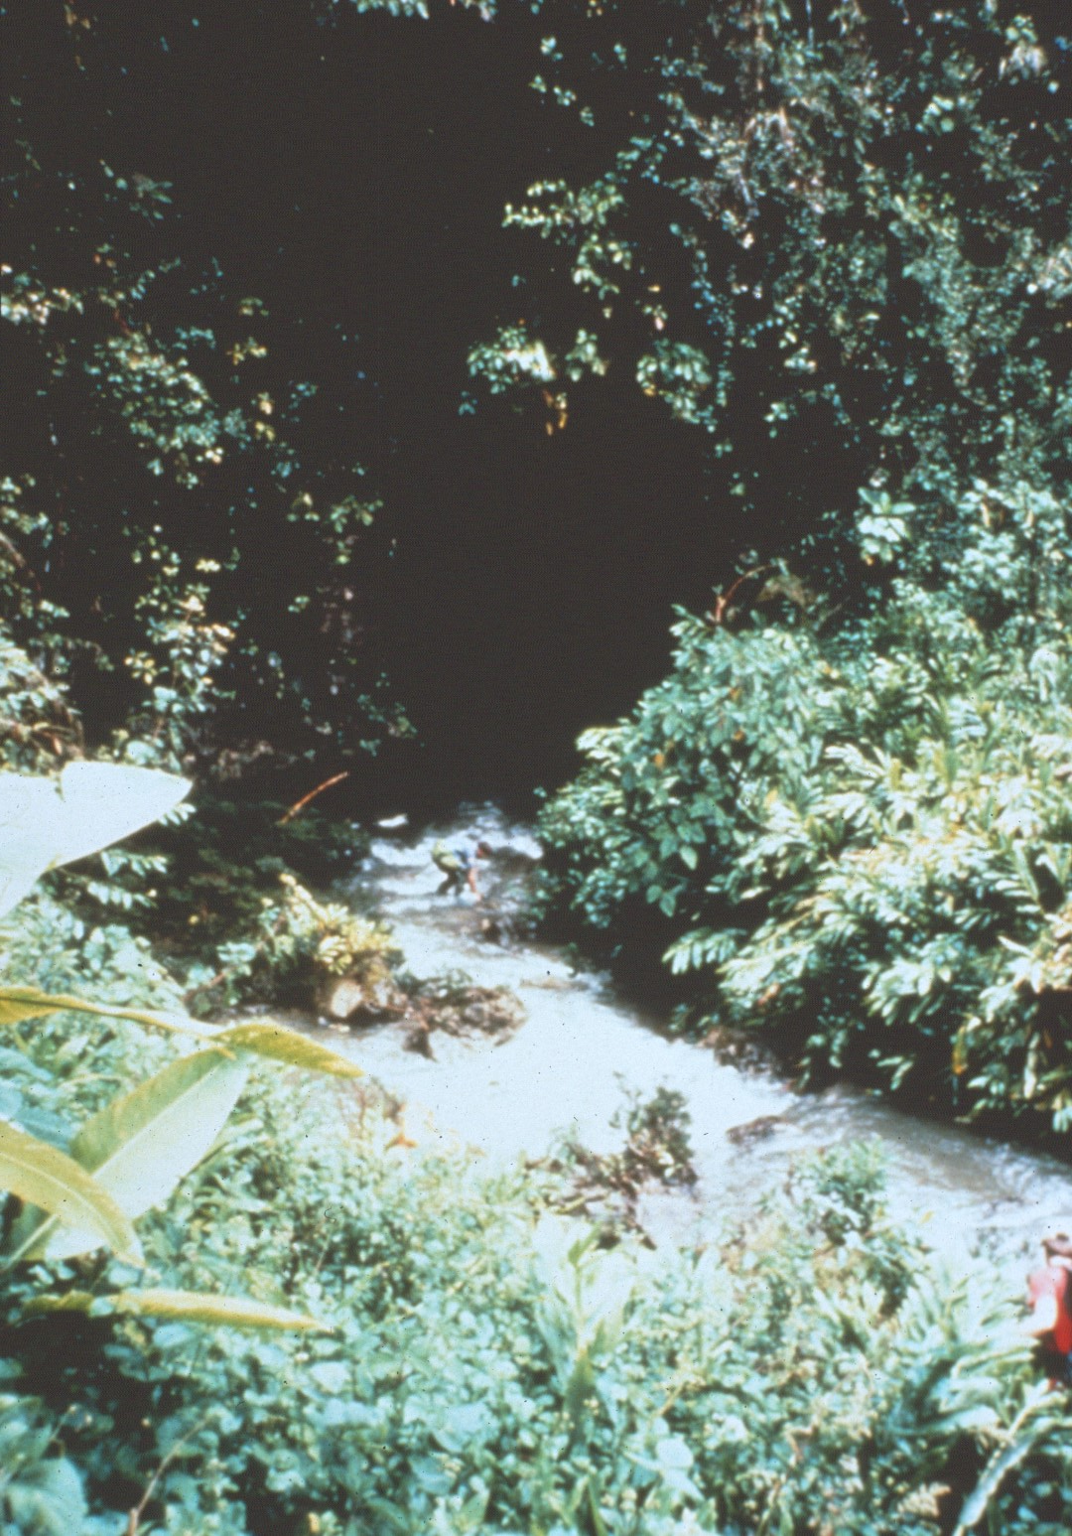
Notes:
The Yallehouch stream is active year-around and sinks in a small hole which has yet to be explored.

Slide 39
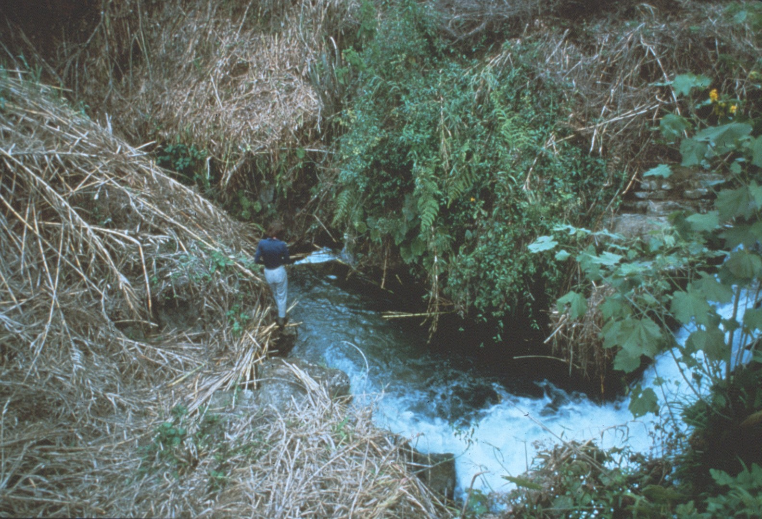
Notes:
While the entrance is small, it looks like a caver could enter it.

Slide 40
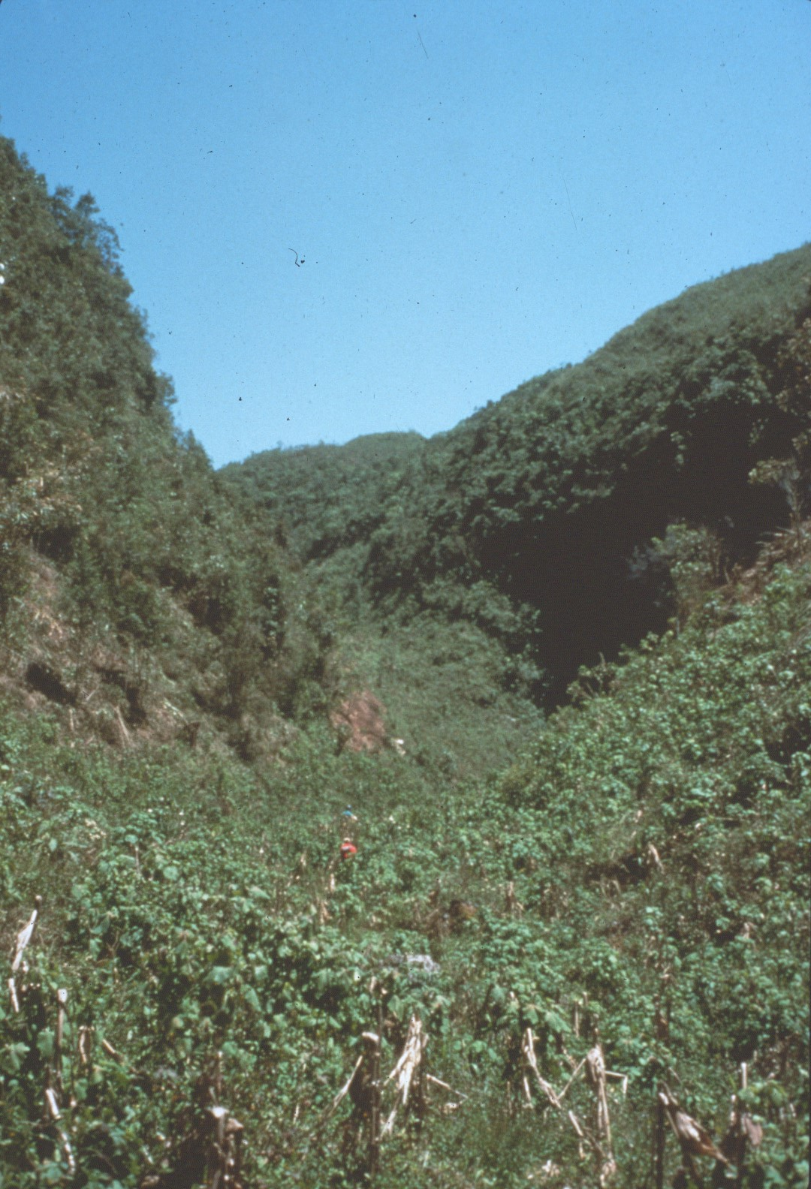
Notes:
The Yallehouch stream used to flow further down the valley into the entrance of Yo Nas Neim Cave.

Slide 41
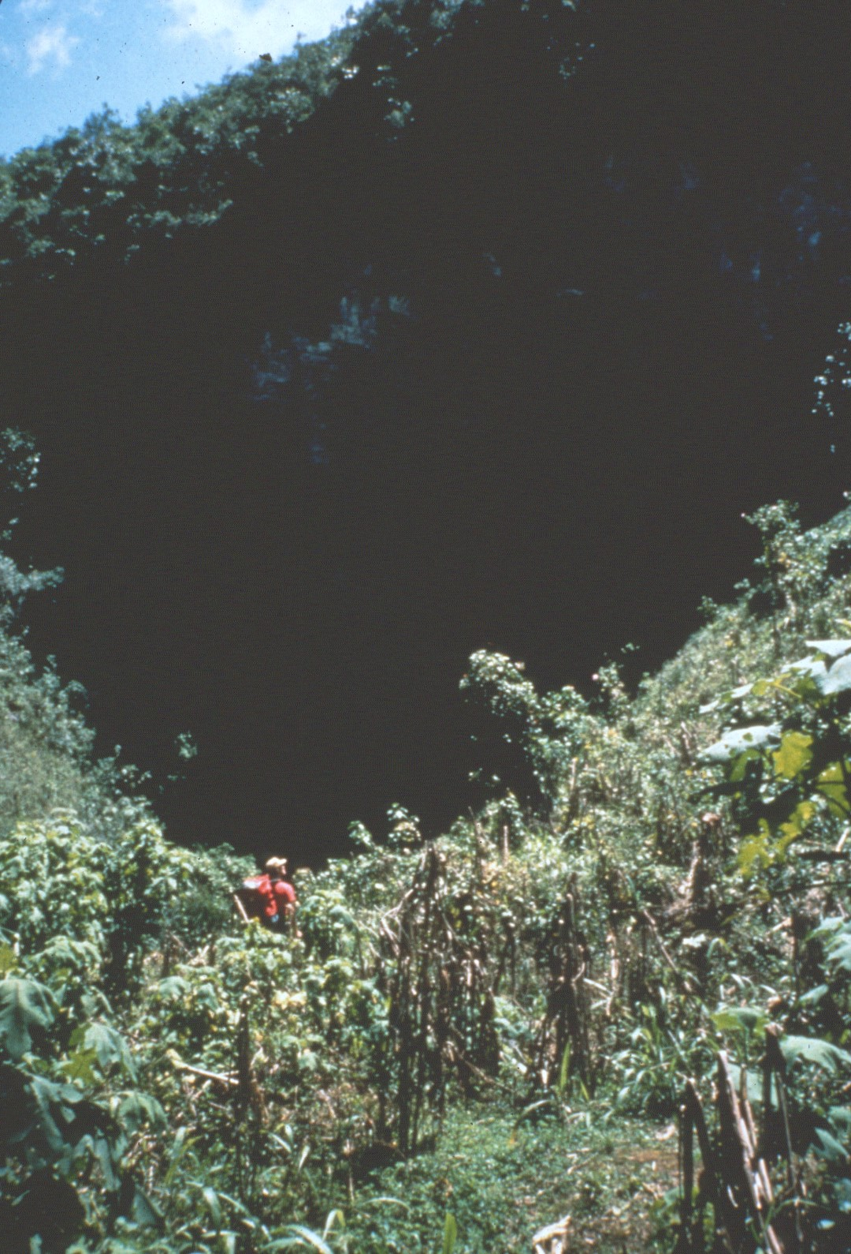
Notes:
The entrance is located in a headwall at the lower end of the valley …

Slide 42
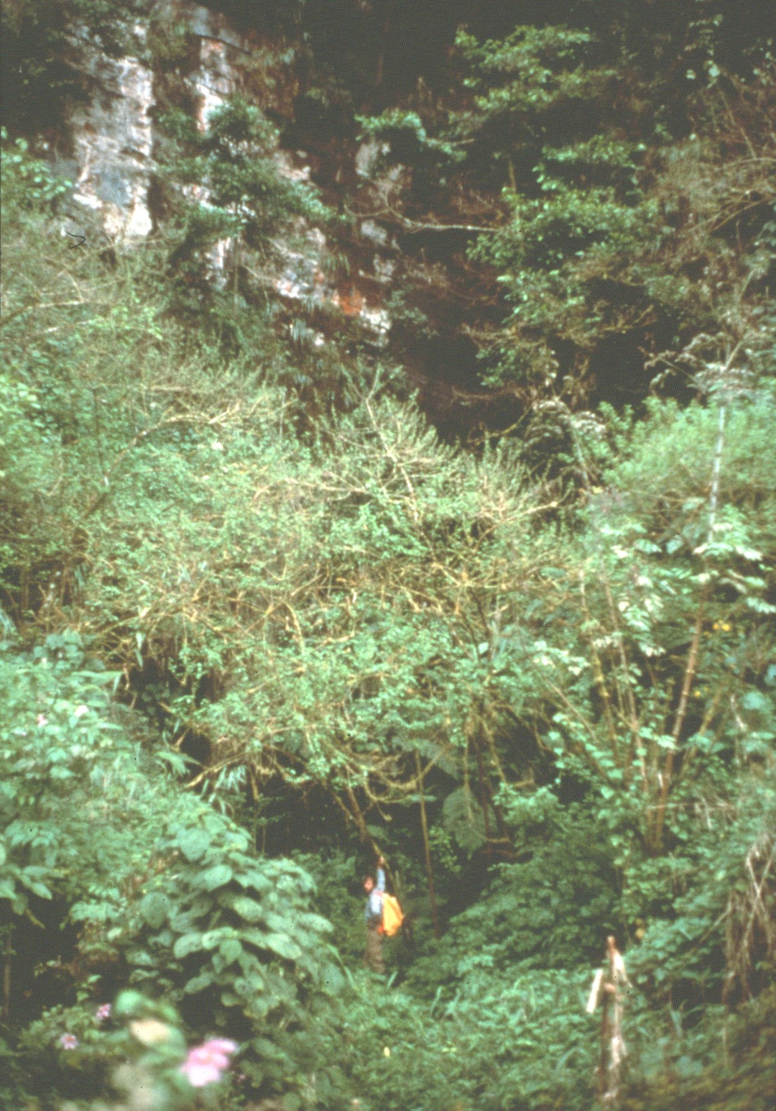
Notes:
Which is covered with heavy vegetation.

Slide 43
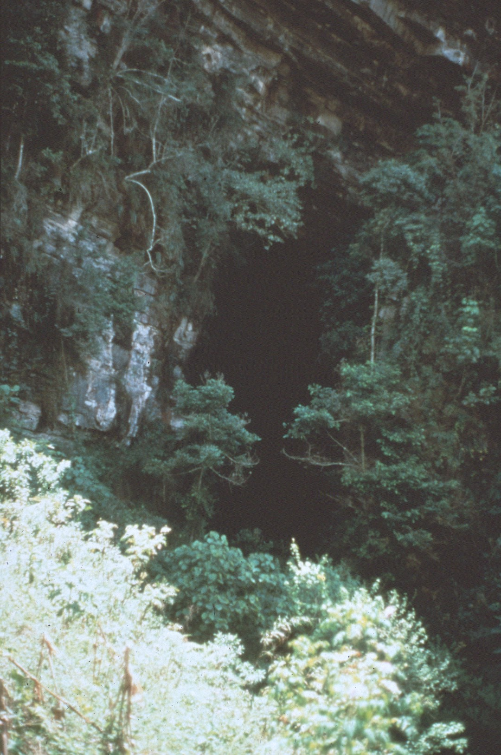
Notes:
The entrance measures over one hundred feet high and forty feet wide.

Slide 44
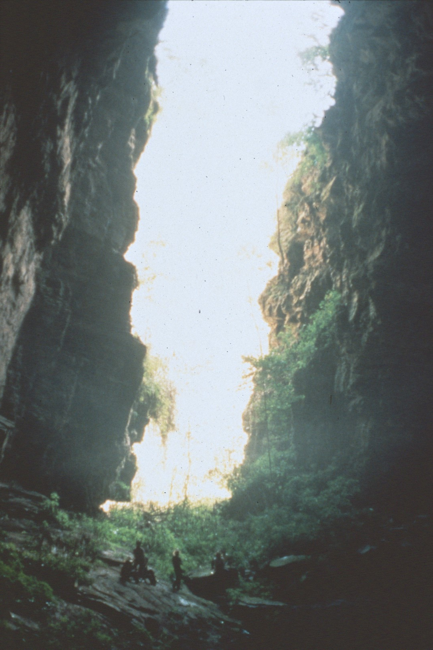
Notes:
Once inside, cavers are dwarfed by its immensity.

Slide 45
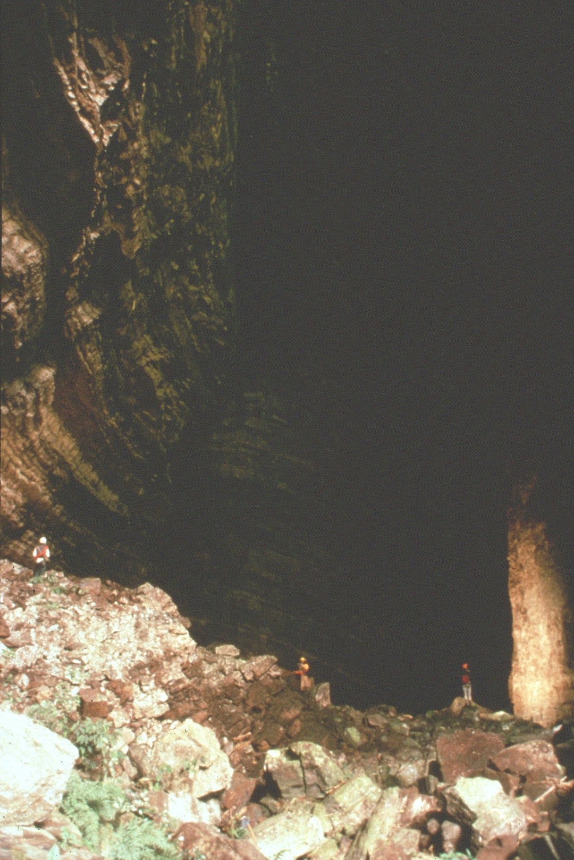
Notes:
Leading from it, a large borehole passage goes into the mountain.

Slide 46
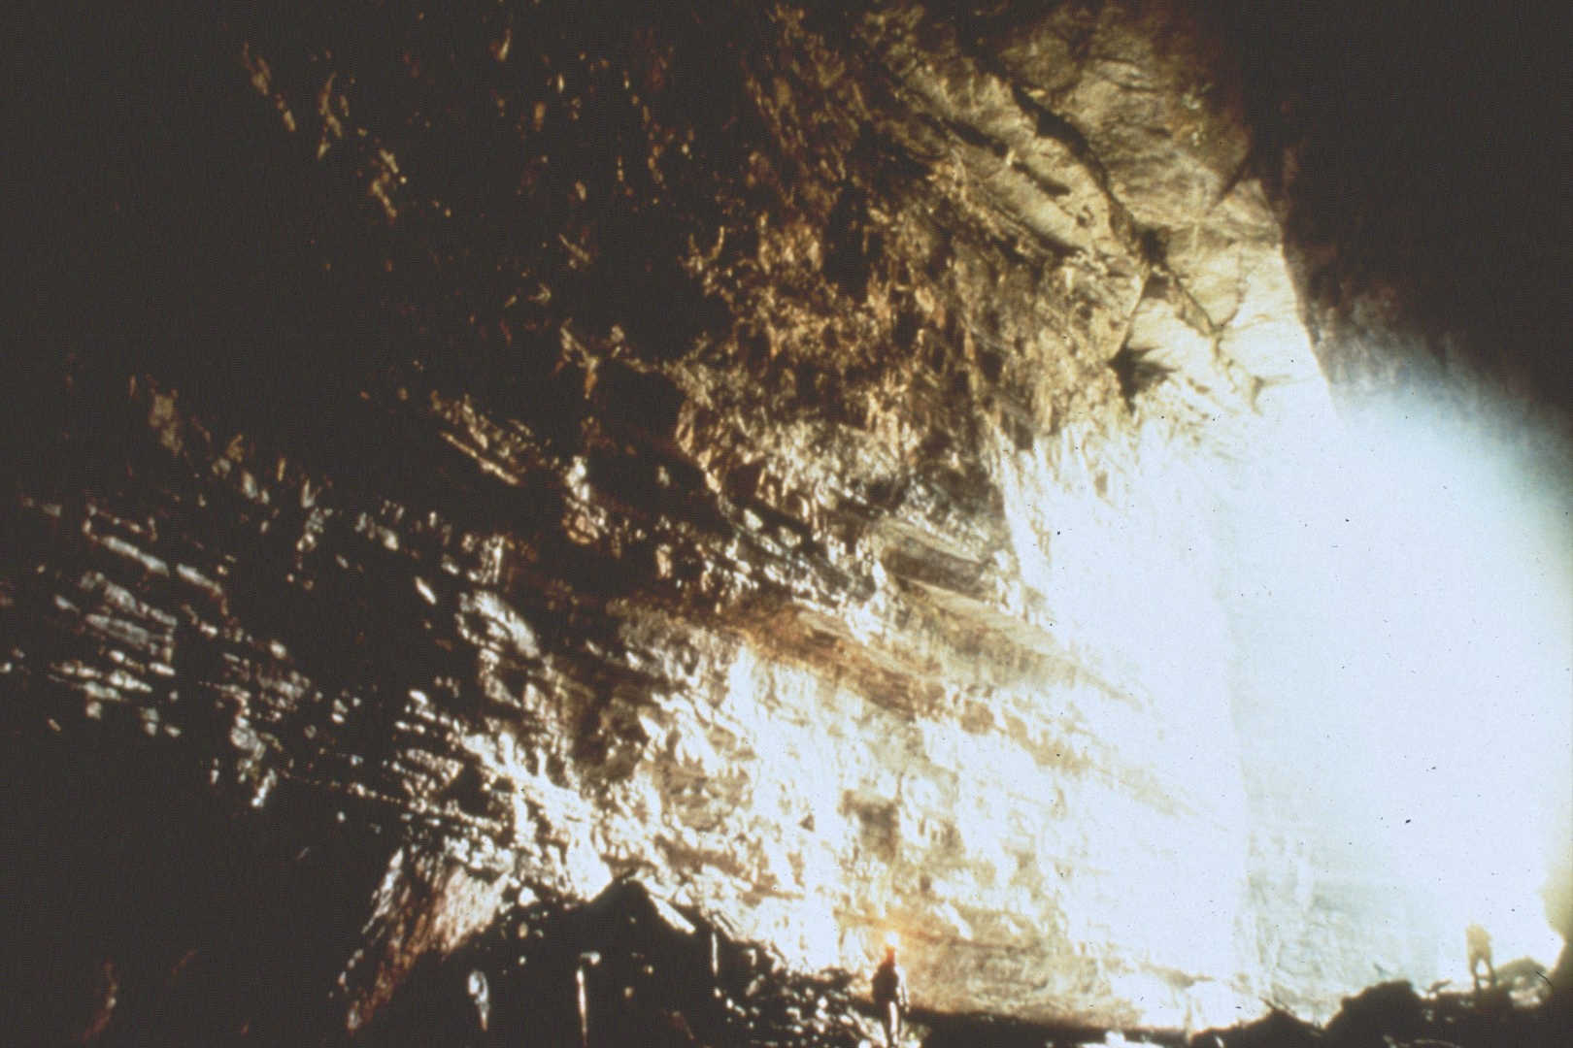
Notes:
After looking at daylight one last time, …

Slide 47
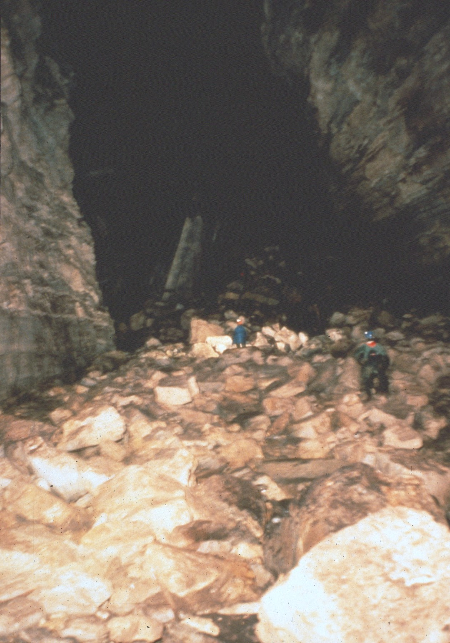
Notes:
The cavers began their journey into Yo Nas Neim.

Slide 48
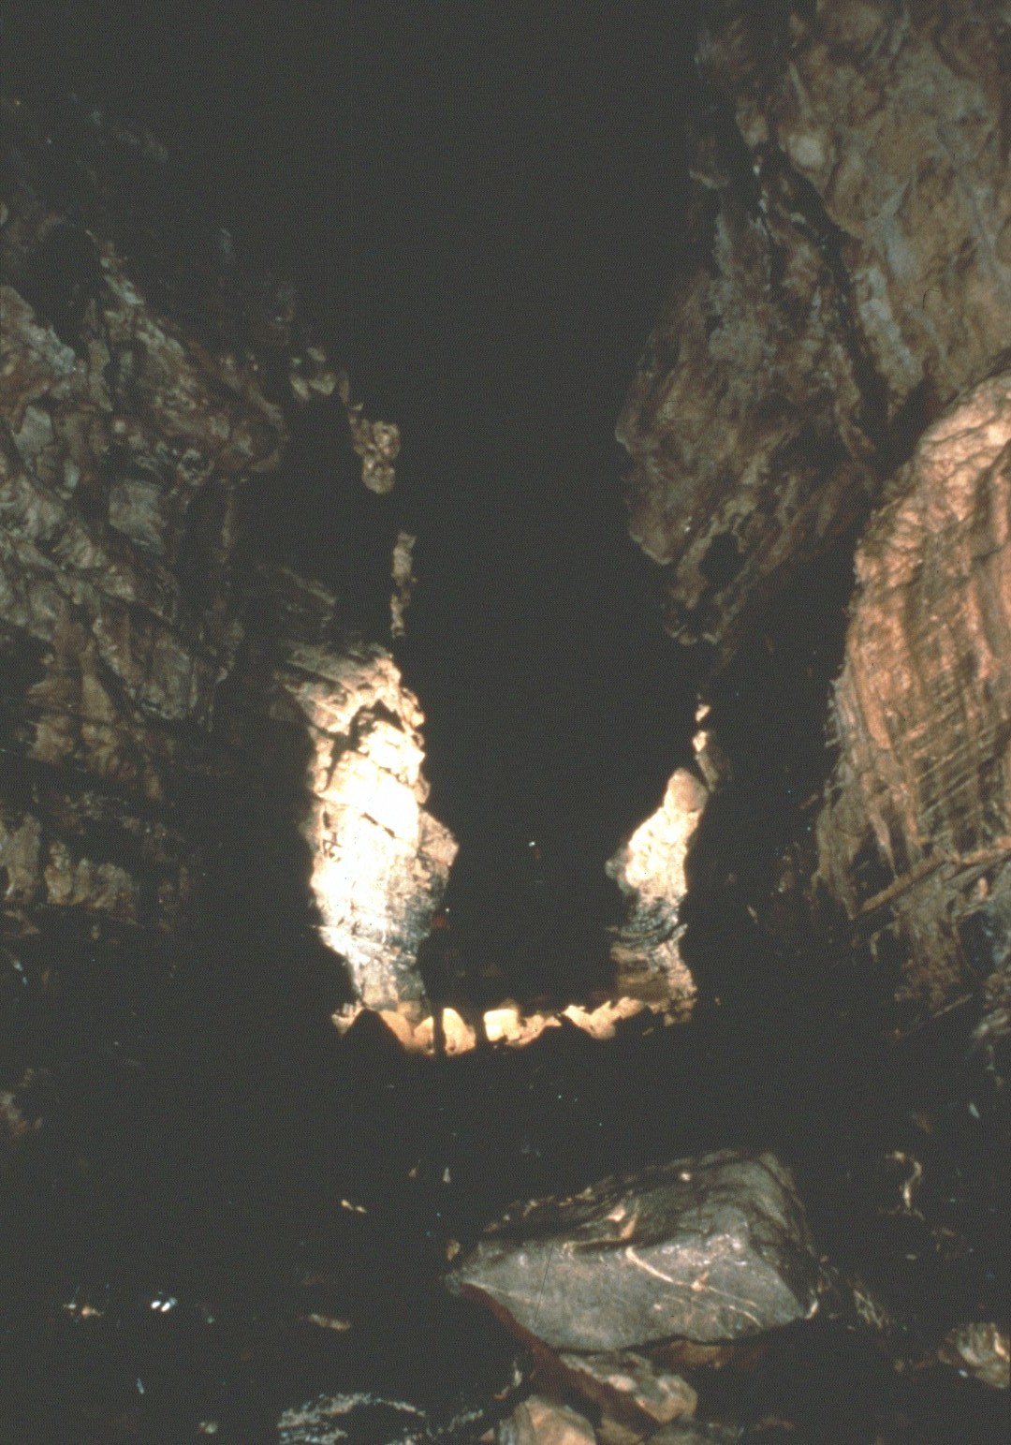
Notes:
The cave started as a single large passage.

Slide 49
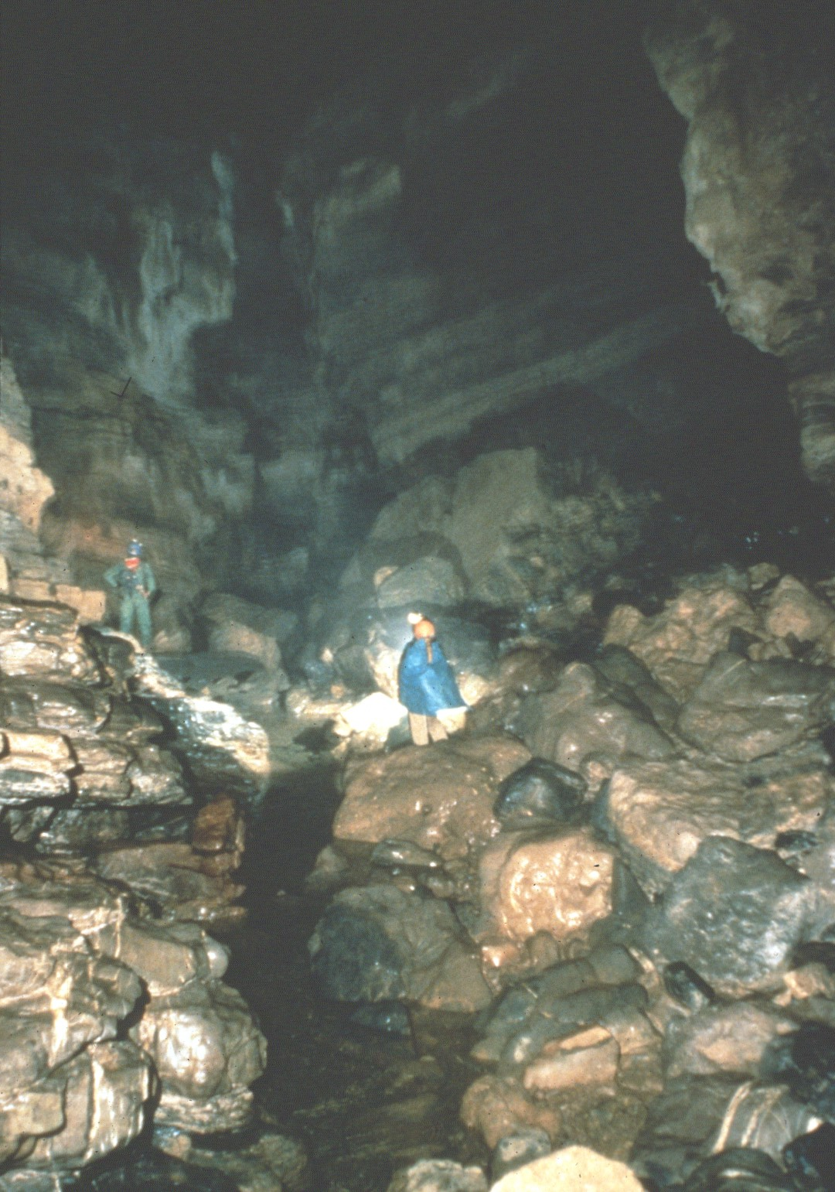
Notes:
In places there was a small stream, but it soon disappeared.

Slide 50
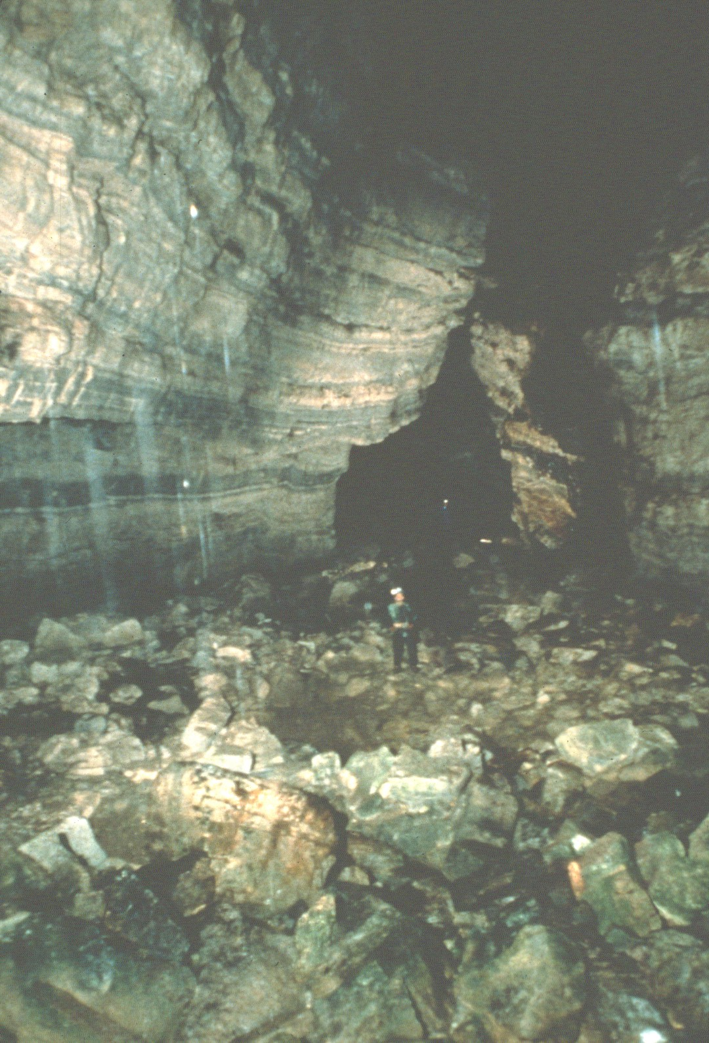
Notes:
Even in the lower sections of the cave, they never found any sign of the main stream from Yallehouch Valley.

Slide 51
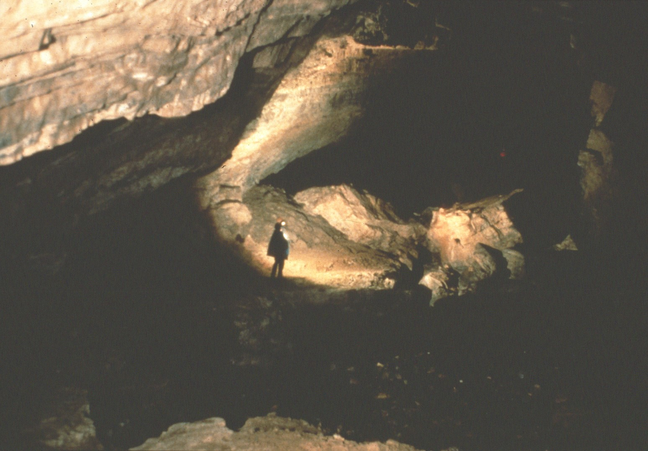
Notes:
Periodically water would enter from above, but then it would go down a drain without forming a stream.

Slide 52
Notes:
Breakdown often littered the floor of the passage.

Slide 53
Notes:
Eventually the cavers had to descend a short drop.

Slide 54
Notes:
While the drop was wet, the water disappeared at the bottom.

Slide 55
Notes:
This was only the first of a series of short drops, …

Slide 56
Notes:
And climbs as they continued into the cave.

Slide 57
Notes:
Eventually the cave broke up into a complex pattern of passages.

Slide 58
Notes:
There was considerable air flow in various places in the cave.

Slide 59
Notes:
But the air flow disappeared in the maze.

Slide 60
Notes:
Farther into the cave they intersected a deep pit along a fault.

Slide 61
Notes:
After placing bolts and tying off the rope, they started down.

Slide 62
Notes:
They carried additional rope in case more drops were found farther into the cave.

Slide 63
Notes:
The descent into the pit was along a wall.

Slide 64
Notes:
It consisted of a series of four drops interrupted by short shelves along the way.

Slide 65
Notes:
The pit depth measured 360 feet when they reached the bottom.

Slide 66
Notes:
At the bottom was a Great Hall going off into the distance. Standing at the far end they could see fellow cavers at the top of the drop.

Slide 67
Notes:
Heading off the Great Hall were large canyons.

Slide 68
Notes:
Occasionally they were blocked by breakdown which required them to squeeze through large blocks of rock …

Slide 69
Notes:
Only to find more tall canyon beyond.

Slide 70
Notes:
At places fill occupied the floor of the passage making it considerably smaller.

Slide 71
Notes:
Every once in a while, the way was interrupted by short drops.

Slide 72
Notes:
As they continued to explore the cave, they found several formation areas.

Slide 73
Notes:
Soda straws were particularly common …

Slide 74
Notes:
And some of them were quite large.

Slide 75
Notes:
At one place they found a soda straw which had fallen and impaled itself in the silt floor.

Slide 76
Notes:
During their surveys they mapped almost six miles of passage, making Yo Nas Neim the longest known cave in Guatemala.

Slide 77
Notes:
When they started back out, …

Slide 78
Notes:
Yo Nas Neim had been surveyed to a depth of 964 feet.

Slide 79
Notes:
It was the deepest known cave in Guatemala until 1990 when a nearby pit further up on the mountain was found to be deeper.

Slide 80
Notes:
Finally, they reached the entrance carrying all their gear.

Slide 81
Notes:
The next morning the Yallehouch Valley was covered by mist.

Slide 82
Notes:
Some of the cavers had come from Belize before arriving in Yallehouch Valley. They spent time digging beef worms out of their skin (photo of ½ inch beef worm). Lucky for the other cavers, beef worms do not live in the cold climate of the valley.

Slide 83
Notes:
The cavers washed their gear in the main stream of the Yallehouch. Al the end of the dry season the water flow was measured at 7 cubic feet per second. However, after a heavy rain they saw the flow at a rate increase to as much as 100 cubic feet per second.

Slide 84
Notes:
The cavers headed up the sides of the valley towards one of the higher entrances of Yo Nas Neim.

Slide 85
Notes:
To get there they had to struggle through heavy jungle undergrowth.

Slide 86
Notes:
It took considerable time and effort just to go a short distance.

Slide 87
Notes:
The struggle seems endless

Slide 88
Notes:
Finally, they reached the entrance.

Slide 89
Notes:
Just inside the entrance they found a piece of an old jar.

Slide 90
Notes:
Pieces of ancient jars. None of the relics were outstanding.

Slide 91
Notes:
Nearby was a partial human skeleton.

Slide 92
Notes:
The platforms were located at the edge of a drop into a lower level of the cave.

Slide 93
Notes:
Perhaps this may have been a Mayan ceremonial site.

Slide 94
Notes:
In one area the platforms were large enough for groups of people.

Slide 95
Notes:
But off on one side was a little circular platform just big enough for one person, perhaps the priest who conducted the ceremony.

Slide 96
Notes:
The cavers spent a lot of time checking along the sides of the Yallehouch Valley.

Slide 97
Notes:
They hired the local residents as porters to help carry the rope to make it easier for them and to help the local economy.

Slide 98
Notes:
Some of these pits were clogged with vegetation.

Slide 99
Notes:
The lead caver had to chop his way down with a machete.

Slide 100
Notes:
He had to be careful not to cut the rope on the way down.

Slide 101
Notes:
It was a lot of work to have to descend through a jungle.

Slide 102
Notes:
But once the first man down cleared the way, …

Slide 103
Notes:
It was much easier for those that followed.

Slide 104
Notes:
The pit proved to be 400 feet deep but went nowhere at the bottom.

Slide 105
Notes:
Another one of the pits they found was Rain Drop. It got its name when they had to climb out of it through heavy rain.

Slide 106
Notes:
The entrance pit was 250 feet deep.

Slide 107
Notes:
It led to cave passage at the bottom that eventually descended in a series of drops to a depth of 800 feet.

Slide 108
Notes:
The Yallehouch Valley is an entirely enclosed depression.

Slide 109
Notes:
The road out of the valley ascends onto the surrounding uplands.

Slide 110
Notes:
The cavers left the road to follow an ancient trail.

Slide 111
Notes:
These deeply entrenched trails have been used for centuries. They were well established routes long before the Spaniards arrived.

Slide 112
Notes:
In the uplands above the valley is a pit called Pozo de Cepalao.

Slide 113
Notes:
It was found by Steve Knutson in 1987.

Slide 114
Notes:
The cavers rigged the rope at the top of the pit.

Slide 115
Notes:
There were few good anchors, so they tied the rope to everything they could find.

Slide 116
Notes:
Finally, they started down the pit.

Slide 117
Notes:
The entrance pit was 230 feet deep.

Slide 118
Notes:
It was clean and dry.

Slide 119
Notes:
Not far from the base of the entrance pit was another short drop.

Slide 120
Notes:
After walking along a canyon for some distance they encountered another major drop.

Slide 121
Notes:
First, they set bolts at the top of the drop.

Slide 122
Notes:
Then they descended. The pit proved to be 470 feet deep.

Slide 123
Notes:
At the bottom of the 470-foot drop, the passage continued but was filled with several deep pools.

Slide 124
Notes:
Continuing down the passage they encountered a small stream which would later flood after a heavy rain outside.

Slide 125
Notes:
The cavers descended another short drop …

Slide 126
Notes:
And then a 230-foot pit.

Slide 127
Notes:
While the cavers were still in the cave, it started to rain outside.

Slide 128
Notes:
The water quickly flooded several passages in the cave. The cavers had to wait several hours before the water flow abated enough that they could make their way out.

Slide 129
Notes:
As of 1990 Pozo de Cepalao has been pushed to a depth of 1,400 feet making it the deepest cave in Central America.

Slide 133
An NSS Audio-Visual Library Presentation
Guatemala Caves
By Steve Knutson
1992
National Speleological Society
6001 Pulaski Pike
Huntsville, AL 35810-1122
256- 852-1300
nss@caves.org
https://caves.org/
Original slide program S627
Slide program produced by Paul Stevens
Slides digitized by David Caudle
PowerPoint program created by David Socky
Script transcribed by Mary Sue Socky
130 slides, with script in presenter notes
PowerPoint created 1/28/2021

